Slide 1
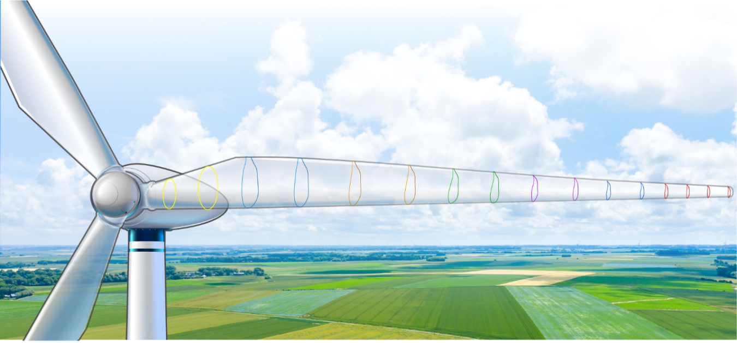




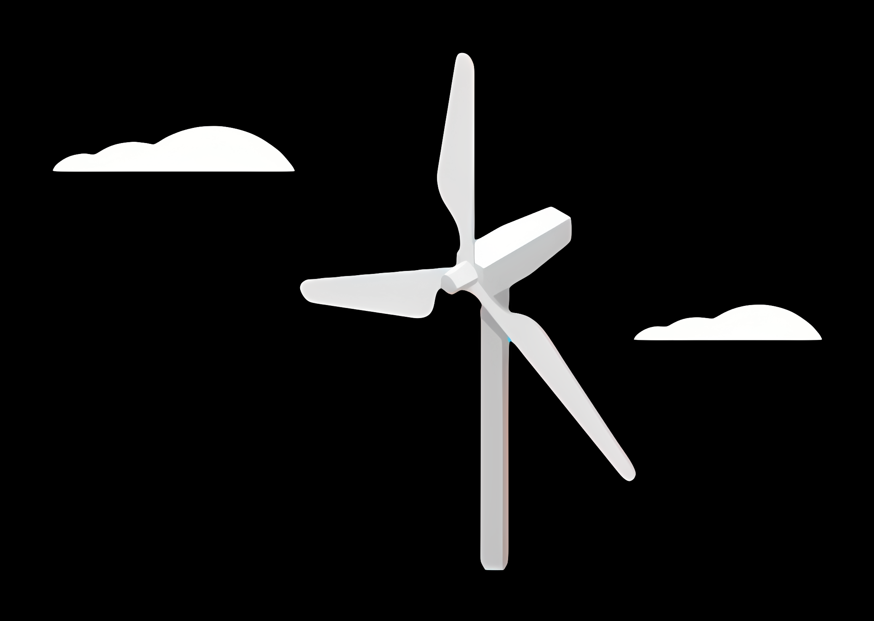
Optimus Syria
1st Week Kick Off Presentation
Date: 23th September 2025

Slide 2
List of contents
Project introduction
Cooperation
Formation & Technical Work
Internal Relations
Project Contact & Agreement
Project Process & Publication
Technology Sizing Decition
A look at Syria
Geopolitical situation
Energy / Electricity supply
Transportation / installation possibilities
Market investigation

Slide 3
1. Introduction
The Optimus Syria project is an interdisciplinary academic–industrial initiative
focused on the design of a complete wind energy converter (WEC) for the Syrian market.
It combines technical, economic, and environmental aspects to deliver a feasible
onshore wind turbine optimized for real deployment under local constraints.
Why a wind Turbine for Syria?
Syria continues to face an energy crisis due to war-related infrastructure damage
The national grid suffers from instability, weak regions, and high dependency on fossil fuels
Wind energy is a cost-efficient and scalable solution with good potential in central and western Syria
This project aims to design a turbine that can realistically be built, transported,
and operated in the Syrian environment , even with limited grid and transport infrastructure.
.

Slide 4
2. Cooperation
This project is carried out in academic cooperation between three institutions:
• Hochschule Flensburg (Lead institution)
• Fachhochschule Kiel
• Damascus University (Syria)
We would like to sincerely thank:
• Prof. Dr.-Ing. Torsten Faber – Head of Energy Technology Institute.
• Prof . Dipl-Ing. Peter Quell – Supervisor of Management & Mechanical Teams.
• All other professors and tutors supporting us.
Your trust and guidance have made this cooperation possible.

Slide 5
3-i. Formation of Technical Teams
The first step in project coordination was the creation of technical sub teams.
• Students were assigned to 15 teams based on their preferences and competencies
• Each team focuses on a specific subsystem: aerodynamics, drivetrain, control, structure, etc.
• Responsibilities were distributed equally to ensure a complete system design
The management team, together with the professors, confirmed all allocations.
1. Windfarm Project Development
2. Loads and Dynamics
3. Feedback Controller
4. Lidar-Assisted Controller
5. Rotor Blade Aerodynamics
6. Rotor Blade Structures
Electrical Drivetrain (EDT)
8. Grid Code Development (GCD)
9. Rotor Hub & Pitch System
10. Rotor Bearing System
11. Gearbox, Brake, Coupling
12. Machine Bed & Yaw System
13. Tower
14. Foundation
15. Storage System

Slide 6
3-i. Formation of Technical Teams
Once teams were defined, we mapped their technical interfaces:
• Each team has dependencies with 2–4 others
• For example:
– Loads Team connects with Blades, Tower, and Controllers
– Drivetrain connects with Controllers, Grid, and Storage
We created a full inter team relationship map to ensure clear communication and avoid isolation.

Slide 7
3-ii. Project Contract and Agreements
To formalize the process, a project contract was prepared and signed with
Prof. Peter Quell and all team leaders.
This contract defined:
• Roles and responsibilities
• Communication expectations
• Timeline milestones and reporting structure
• Risk management strategies
• Weekly general assembly rules

Slide 8
3-iii. Project Process and Publication
To ensure transparency, documentation, and collaboration,
a public GitHub repository and homepage were created:
Website: https://karim-bakhtyar.github.io/Optimus-Syria-WEC/
This platform includes:
Team allocations and responsibilities
Weekly progress reports
Project timeline and Gantt charts
Live status tracking by team
Document archive and references
The website allows both internal team members and external stakeholders
to follow the progress of the Optimus Syria WEC project in real time.

Slide 9
4. Technology Sizing Decition
The next milestone was selecting the turbine size and class.
We studied:
Existing wind projects in Syria (2.5 MW baseline)
The new 100–200 MW tender by the Syrian Ministry (PETDE)
Grid, transport, and site conditions in central Syria
After analyzing market, logistics, and energy yield, we selected a 5 MW turbine.
Why 5 MW Platform?
Matches global standard onshore platforms (Vestas, Siemens, Nordex)
Reduces cost per MW by minimizing crane, pad, and cable needs
Offers high energy capture in 7–9 m/s Syrian wind sites
Requires fewer units for 100 MW+ deployment
Future-proof for tenders and long-term integration
This size balances ambition with deliverability under Syrian constraints.

Slide 10

5-i. Geopolitical situation
General info
Population: 25,255,139 inhabitants
Territory: 185 180 km²
Density: 118.3/km²
GDP total: $50.28 billion
GDP per capita: $3,300
Form of government: Unitary presidential republic under a provisional government
Current head of the government: Ahmed al-Sharaa
Capital city: Damascus
Recent political instabilities
Syrian civil war began in 2011 during the Arab Spring
ISIS joined in 2014, briefly defeating Assad’s forces
Russia and Iran intervened, helping Assad push back and defeat ISIS
Rebel forces ultimately overthrew Assad’s government in December 2024
[1]
[A]

Slide 11
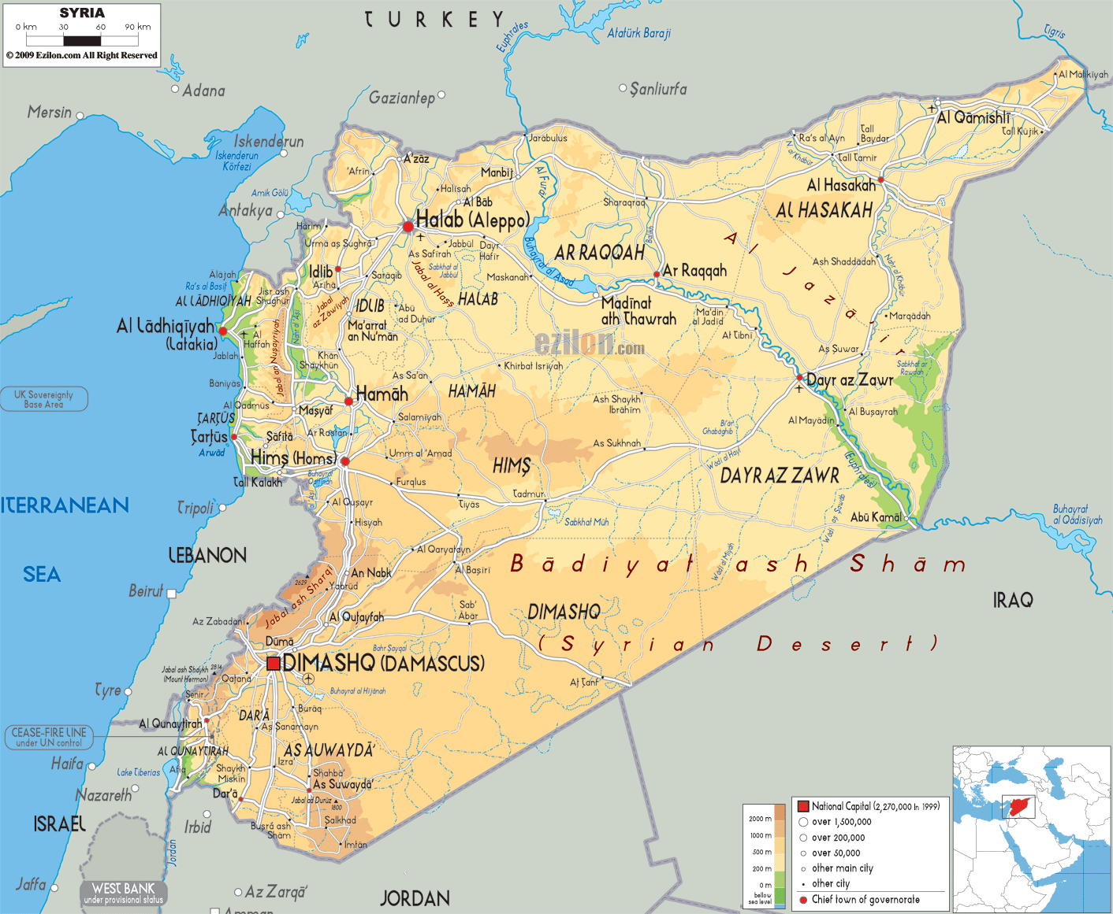
5-i. Geopolitical situation
Geographical situation
Mountain ranges in the west
Flat litoral close to the coasts
Steep inland area
Coastline - 193 kilometres
Border countries
Iraq 605 kilometres
Israel 76 kilometres
Jordan 362 kilometres
Lebanon 394 kilometres
Turkey 822 kilometres
Biggest ports
Latakia and Tartus
[1]
[B]

Slide 12
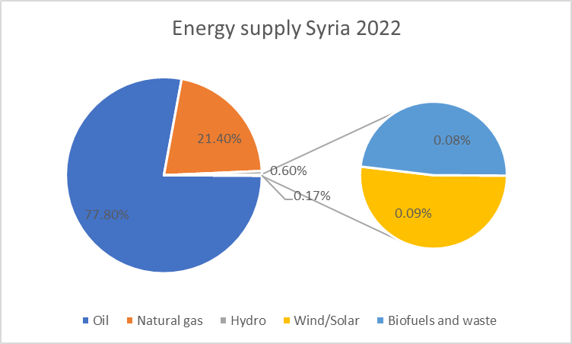
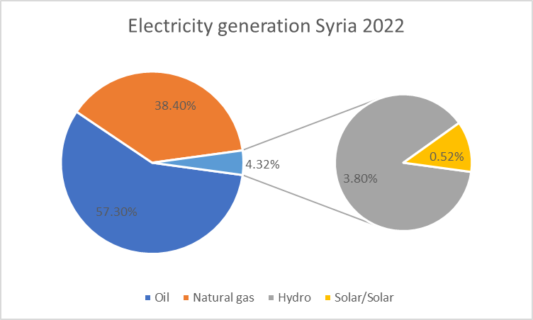
5-ii. Energy / Electricity supply
[2]

Slide 13
5-iii. Transportation / installation possibilities
Transportation / installation
Three main motorways in Syria: M1 (174 km) connects Latakia and Homs
M4 (120 km) connects Latakia and Saraqib
M5 (450 km) connects the north to the south
Two major transport companies from Turkey are availabel (Hazar Lojistik, Metronak)
One construction company for installation from Syria (ZEIN BROTHERS & CO.)
[3], [4], [5]

Slide 14
5-iv. Market investigation
Market participants
Syria:
WDRVM -> turbine manufacturer
Turkey:
SoyutWind -> turbine manufacturer
Gesbey -> tower manufacturer
Nordex -> Turbine delivery
Enercon -> Turbine delivery
Vestas -> Turbine delivery
Goldwind -> Turbine delivery
Suzlon -> Turbine delivery
Siemens Gamesa -> Turbine delivery
[6], [7], [8], [9], [10], [11], [12], [13], [14]

Slide 15
5-iv. Market investigation
Turbine competition in the IEC-Class: IIIA
Turbine manufacturer | Type in the IEC-Class IIIA | Power in MW
Vestas | V136-3.45 | 3.45
Enercon | E-138 EP3 | 4.2
 | E-160 EP5 | 5.56
Siemens Gamesa | SG 4.3-140 | 4.25
Goldwind | GW140/3000 | 3.0
 | GW140/3400 | 3.4
Suzlon | S111/2100 | 2.1
[15], [16], [17], [18], [19], [20], [21]

Slide 16
Tasks of the Summer Break
Project Development Team
Given task by the University (team supervisor was not defined yet):
1. Get into contact with Damaskus University for specific corporation
2. Research on environmental, operational and legal conditions in Syria
Given task by the management team:
3. Find a suitable site for the Optimus Project in Syria, find reasanable values for:
Wind Resource Data
Grid Connection
Infrastructure
Topography
Soil Conditions
Legal Requirements

Slide 17
Our approach
I. Self-study on the topic and the country of Syria
II. Initial meeting with Mrs. Blohm
Getting a sight about how to choose a location.
III. Searching for possible areas, considering…
Wind resource availability (WindAtlas),
Grid connection (InfrastructureMap),
Land use and terrain (Maps+GoogleEarth),
Transportation (Maps),
General infrastructure (Maps),
Legal requirements,
Environmental impact.
IV. Comparison of suitable areas
Pros/Cons List for comparison
Final decision on one area
V. Finding a suitable/available site in the area
VI. Confirmation meeting with Mrs. Blohm

Slide 18
Sharing of Work
Luis Urhahn
Leading the team
Organising the Meetings and communications
Preparation of reports
Giving inputs to the site selection
Ahmed Sallam
No input, attended some meetings
Ceren Cetin
Giving inputs to the site selection
Preparing the presentation
Sohail Mansuri
Giving inputs to the site selection

Slide 19
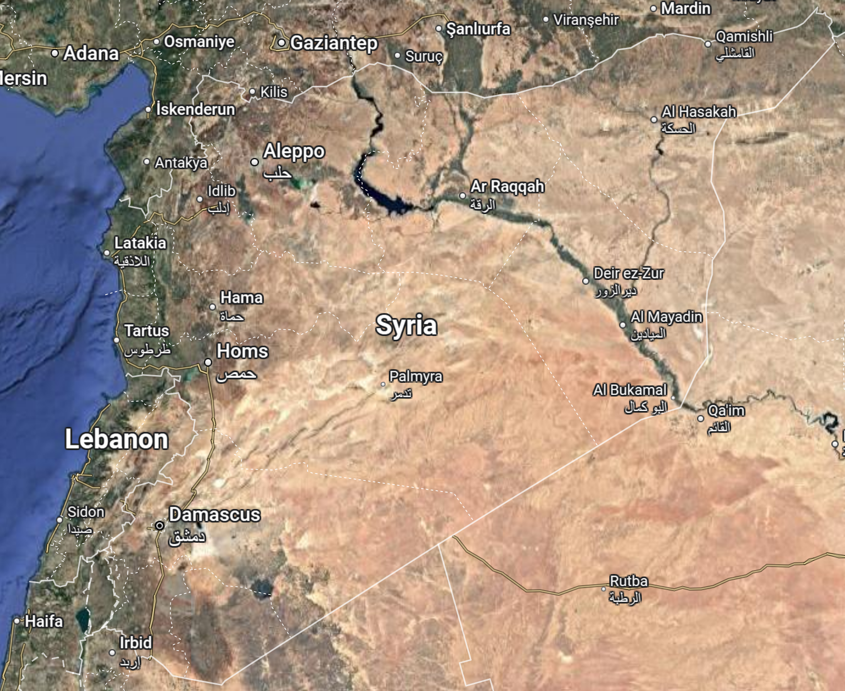
Considered Areas
Area of Maryamayn
Area of Latakia
Area of Ash Sholah
Area of Homs
Area of Barek
Area of
As Suwayda
Figure 1: Overview of Syria [3]

Slide 20
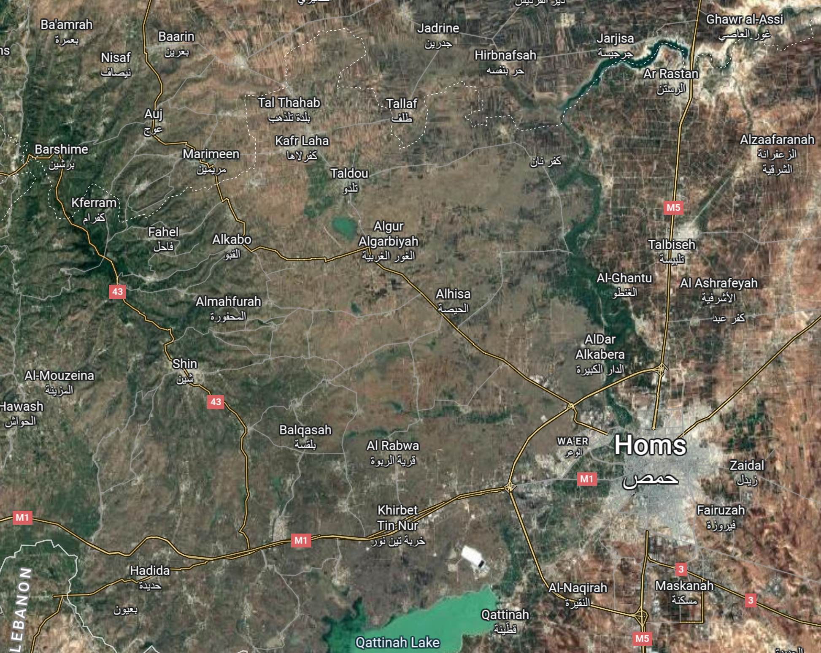
Considered Sites – Around Homs District
Site: Tareen
Site: Tbisah
Site: Sufr
Site: Balqasah
Site: Um Aledam
Figure 2: Overview of the Homs District [3]

Slide 21
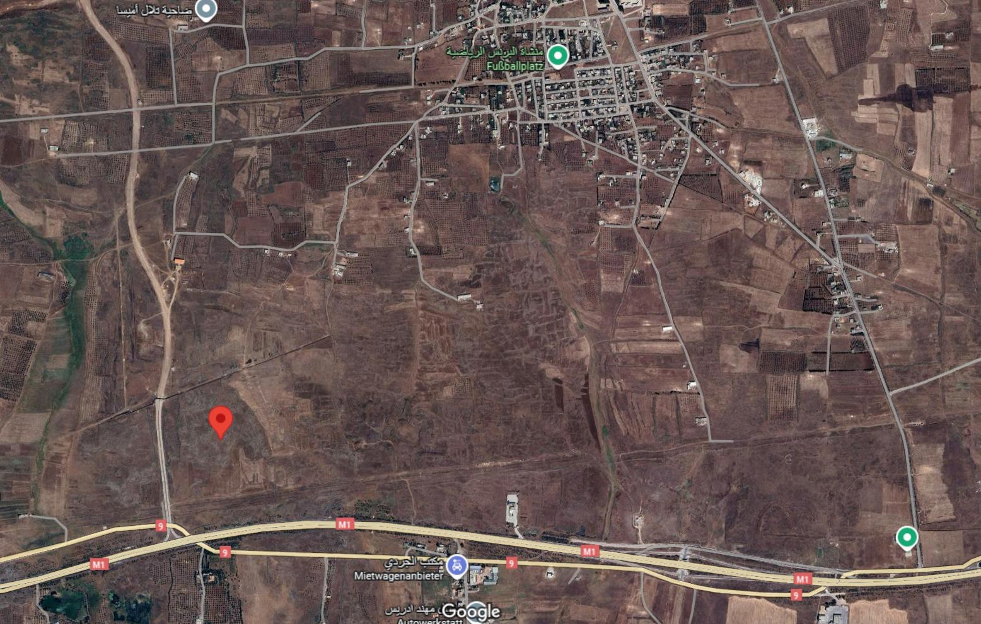

Characterisitcs of the Site – Um Aledam
Located on the countryside of Homs District
Located on the east side of the mountain range
Close access to the main road M1 (highway)
Free area, no farmland or private land (assumption)
Sufficient distance from surrounding buildings (main wind direction)
Existing wind turbines in the area (2 x 2.5 MW)
Latitude: 34° 41' 48.4" N Longitude: 36° 30' 32.5" E
Figure 3: Detailed view of the site [3]

Slide 22
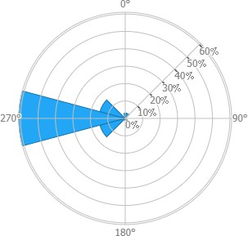
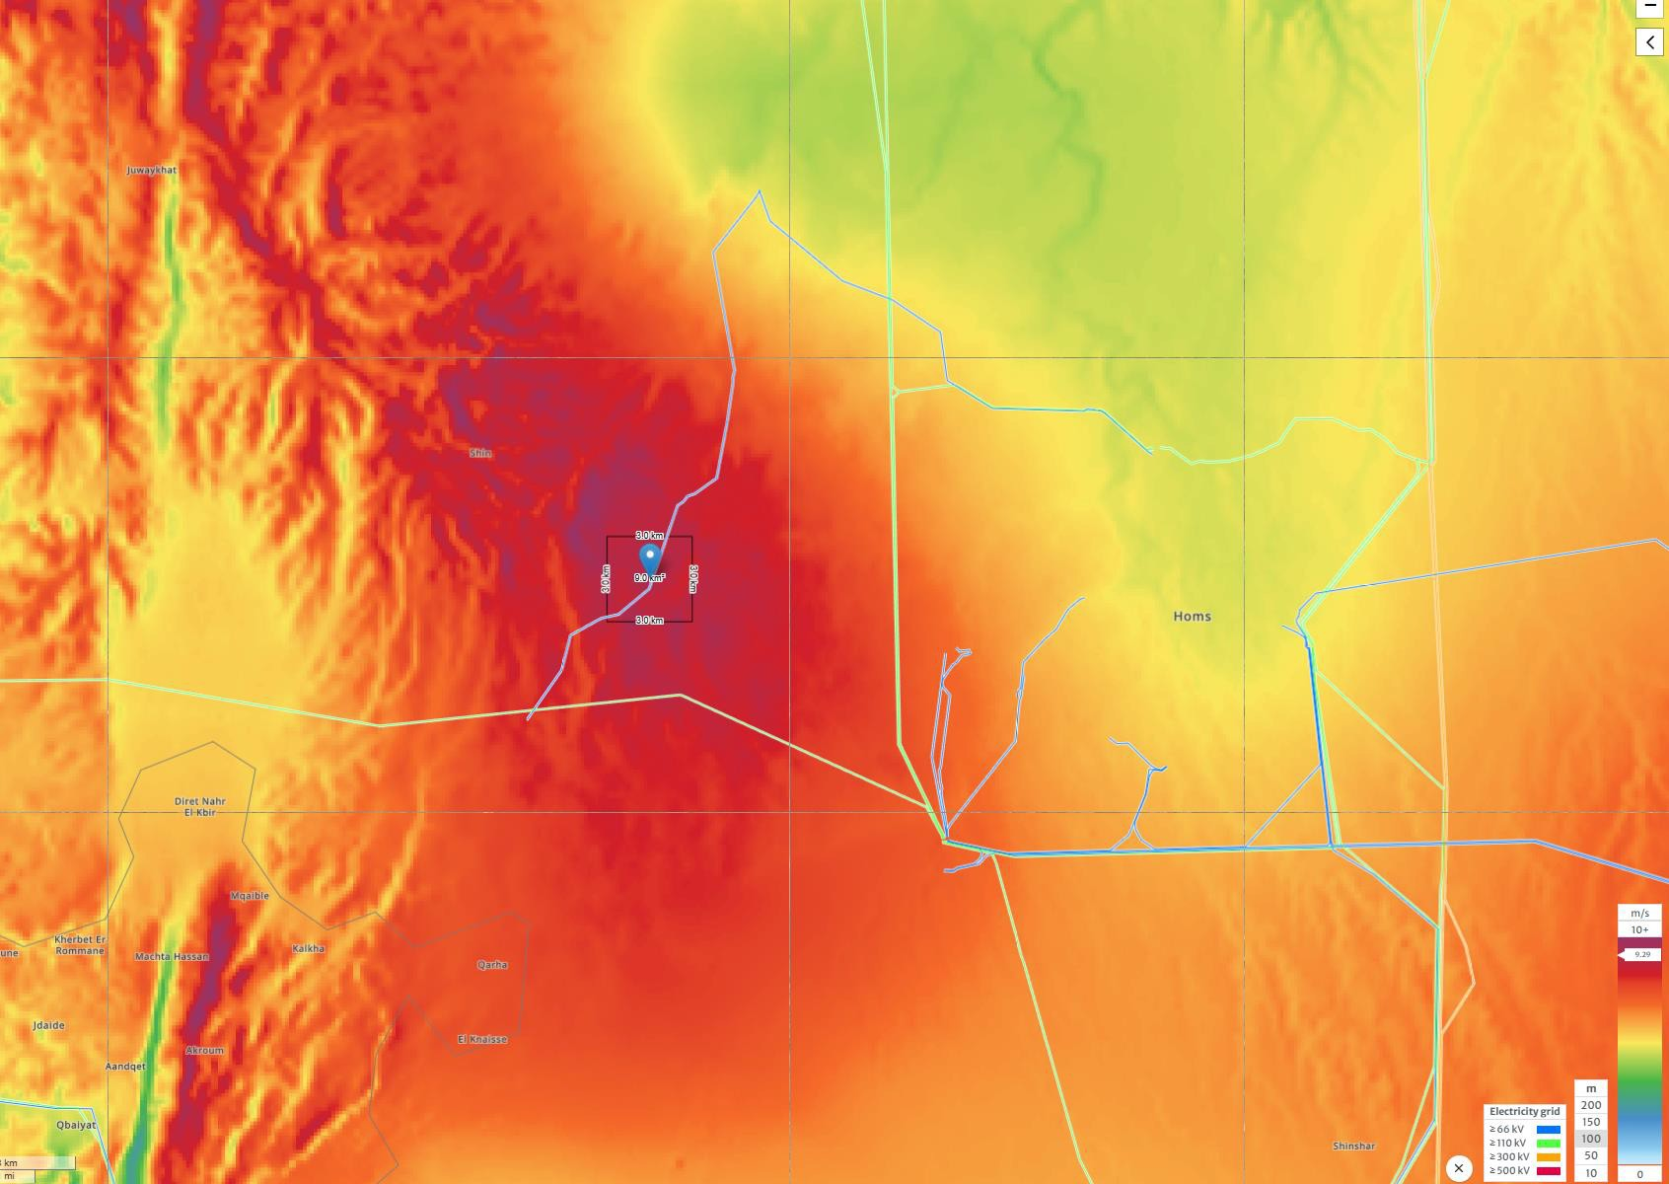
Wind Ressource Data – Um Aledam
Wind Data at HH 100m:
Main Wind Direction: 270° (West)
Average Wind Speed: 9.29 m/s
Wind Capacity: 824 W/m²
Wind Turbine Class: III A
Capacity Factor, IEC Class III: 0.58
→ FLH: 5 080 h
Turbulence Intensity: A
Figure 4: Windrose (Windspeed) [1]
Figure 5: Wind Map [1]

Slide 23
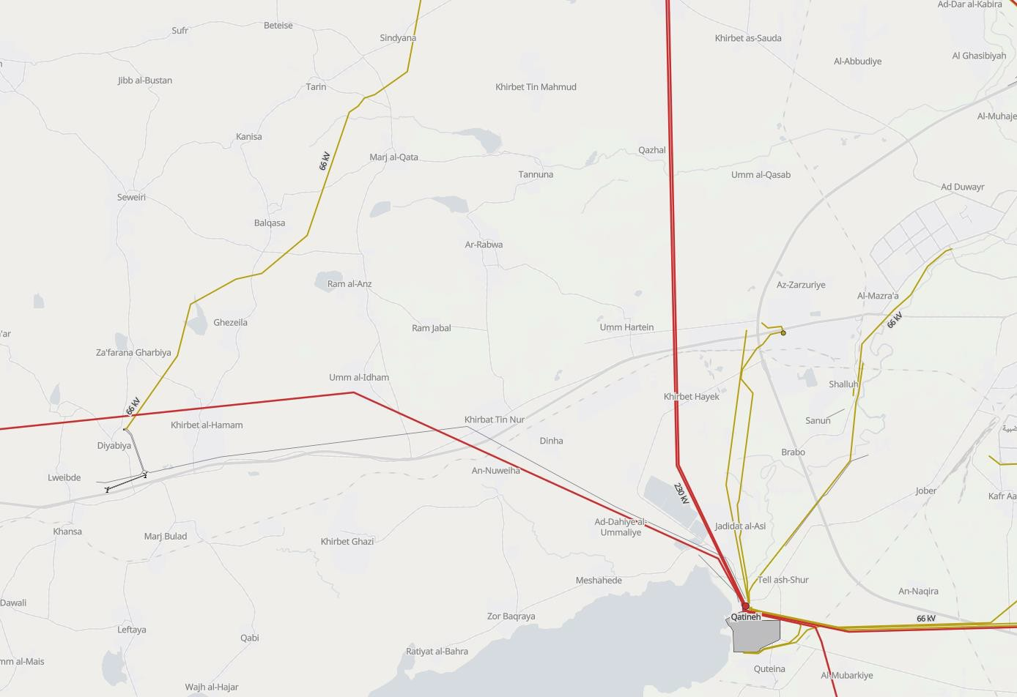



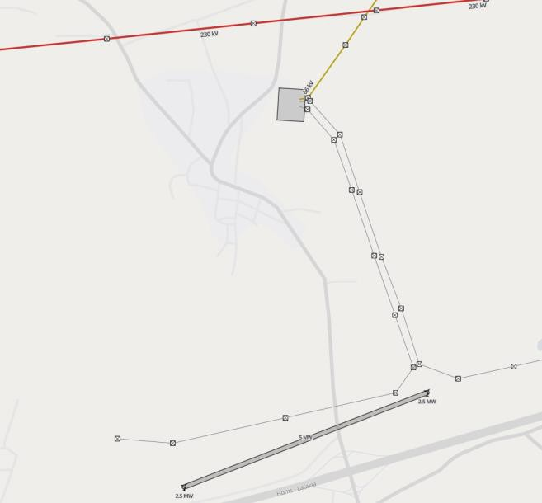




Grid Infrastructure – Um Aledam
Grid Connection (Substation) within 10 km distance
Connected to 66 kV Grid (Grid frequency 50 Hz)
Possibility for connection to 230 kV Grid
Close industry in the City of Homs
Final location of WT
Figure 6:
Grid Map [4]
Existing Substation
(66 kV Grid)
Existing 2x2.5MW WT
Figure 7:
Detailed view of Substation [4]

Slide 24
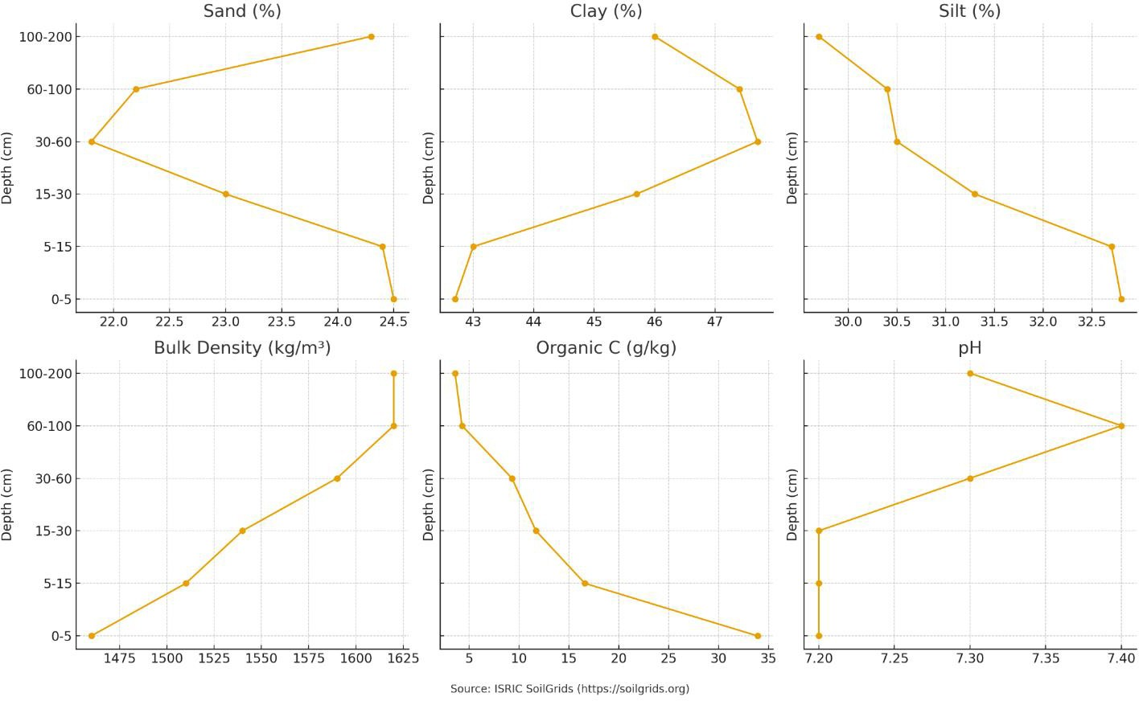
Soil Conditions – Um Aledam
Figure 8: Graph for Soil Conditions [5]

Slide 25
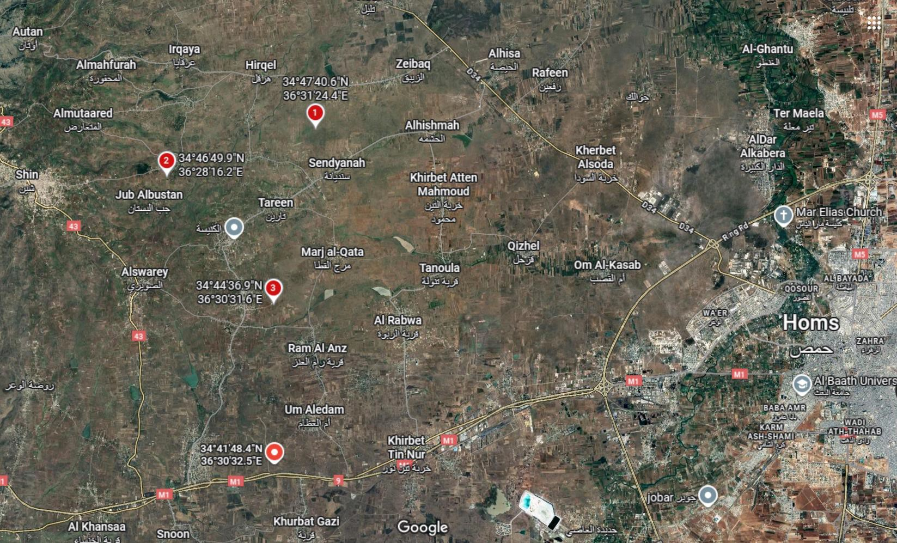
Alternative Locations – Homs District
Alternatives
Current final location
Figure 9: Alternative Sites in Homs District [3]
1. Tbisah
Location: 34.794617° N, 36.523435° E
Farmland, more in the country area
More far away from main street and grid
Slightly better wind conditions
2. Sufr
Location: 34.780536° N, 36.471176° E
In the mountains
More far away from main street and grid
Slightly better wind conditions
3. Balqasah
Location: 34° 44' 36.9" N 36° 30' 31.6" E
More in the countryside
No buildings around the area
More far away from main street and grid
Similar wind conditions

Slide 26
General Information of the Site – Um Aledam
Parameter | Value
Location | Latitude: 34° 41' 48.4" N Longitude: 36° 30' 32.5" E
Average Wind Speed | 9.29 m/s
Main Wind Direction | 270° (West) (more than 95% of the time)
Wind Capacity | 824 W/m²
Wind Turbine Class (IEC) | III A
Grid Connection | 66 kV (or 230 kV), 50 Hz
Substation | 66 kV Substation (approx. 10 km distance)
Air Temperature | ~ 20 °C (max. 37 °C, low. 4 °C)
Humidity | 42%
Air Pressure (Ground level) | 1006 mbar
Roughness length | 0,03
Orography (Terrain height) | 618 m
Environmental conditions | Mostly dry, Farmland, Flat Terrain
Road condition | Good (Highway M1)
Distance to Port | 85 km (Tartous Port)

Slide 27
Agenda
Load and Dynamic
Guidelines Used in Syria
Typical load output sections
Design situations
Simulation Workflow
Needed parameters for the pre-processing
Coordinate systems and components
Estimated Loads for Optimus Syria based on statistics.

Slide 28
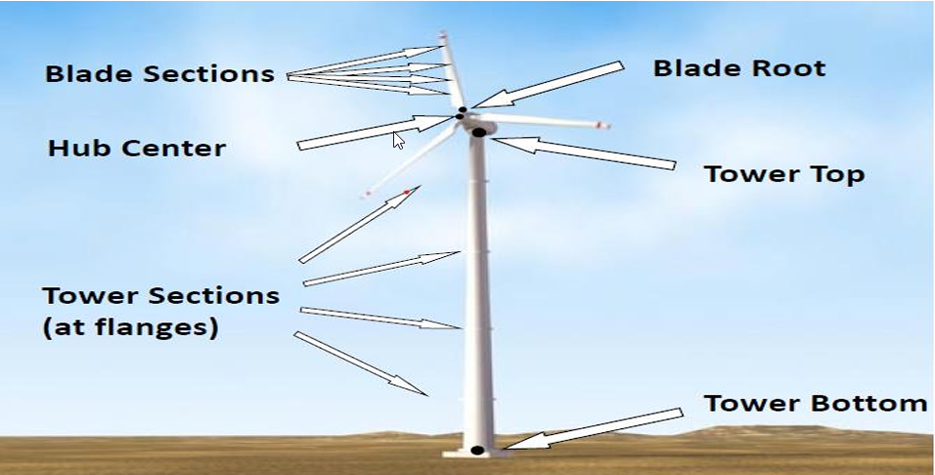
Typical load output sections
Load Output Sections Representation
Source : Load Reports of the previous OPTIMUS projects

Slide 29
Design situations
Power production (DLC 1.X)
Power production + occurrence of fault (DLC 2.X)
Start up (DLC 3.X)
Normal shutdown(DLC 4.X)
Emergency stop (DLC 5.1)
Parked: Standing still or idling (DLC 6.X)
Parked and fault conditions (DLC 7.X)
Transport, installation, maintenance and repair (DLC 8.X)
Source :Loads and site conditions for wind turbines, DNVGL-ST-437,Edition November 2016

Slide 30
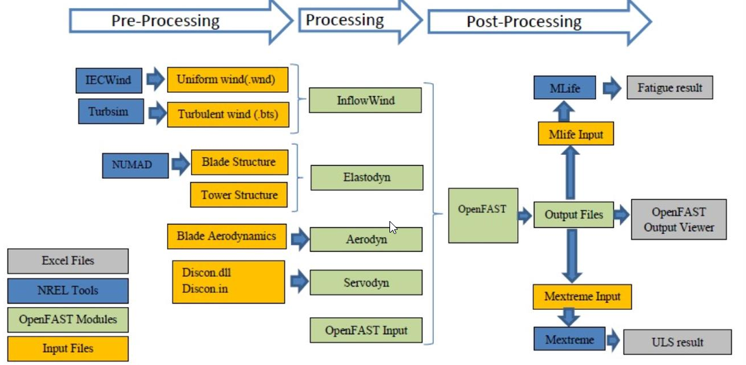
Simulation Workflow OpenFAST
Simulation Workflow
Source : Load Reports of the previous OPTIMUS projects

Slide 31
Needed parameters for the pre-processing
Site assessment:
Wind speed
Wind direction
Air density
Turbulence
Wind shear
Annual distribution
Tower:
Tower height
Mass distribution
Stiffness
Natural frequencies
Rotor blades:
Mass per unit length
Bending stiffness
Torsional stiffness
Natural frequencies
Material properties
Lift coefficient (Cl) and Drag coefficient (Cd) as functions of the angle of attack (AoA).
Blade twist and chord distribution along the blade.
Tip loss and hub loss correction factors
RNA Masses and inertias
Yaw bearing
Rotor Hub
Nacelle inertia about yaw axis
Generator
Control:
Pitch control gain values.
Generator torque control settings.
Set points for turbine operating conditions
Yaw control settings

Slide 32
Coordinate systems and components
Coordinate system | Affected components
Blade coordinate system | Rotor blade Rotor hub, Pitch system
Chord coordinate system | Rotor blade
Hub coordinate system | Rotor hub, Pitch system Rotor bearing system Gearbox, Brake, Coupling Machine Bed, Yaw system
Tower top coordinate system | Machine Bed, Yaw system Tower & Foundation
Support structure (tower) coordinate system | Tower & Foundation

Slide 33
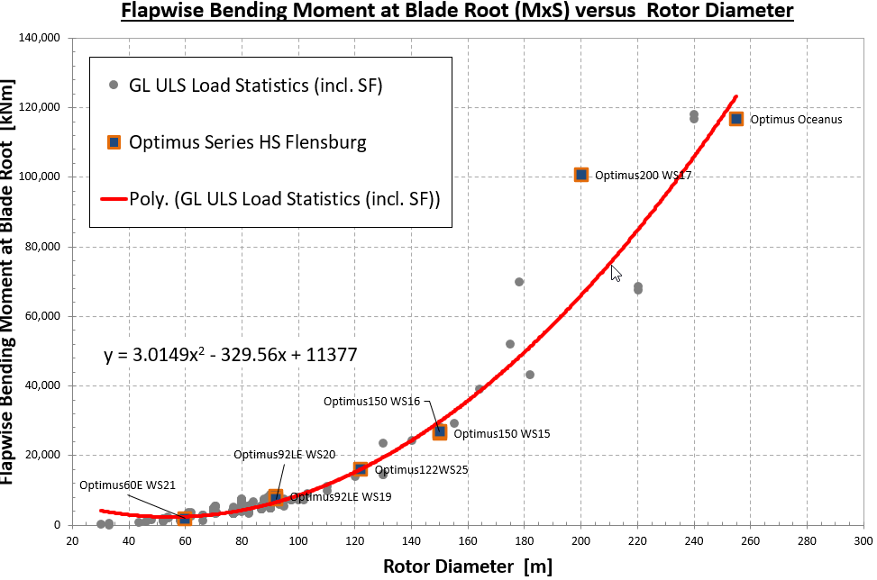
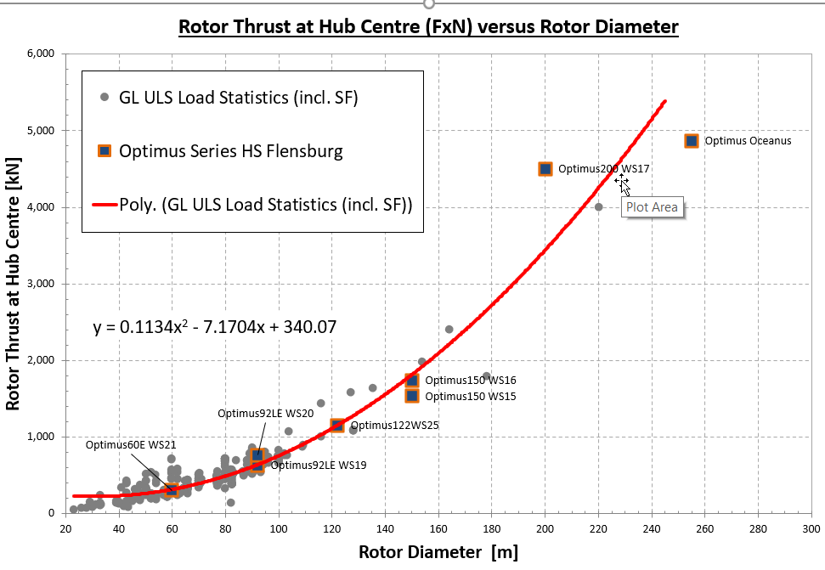
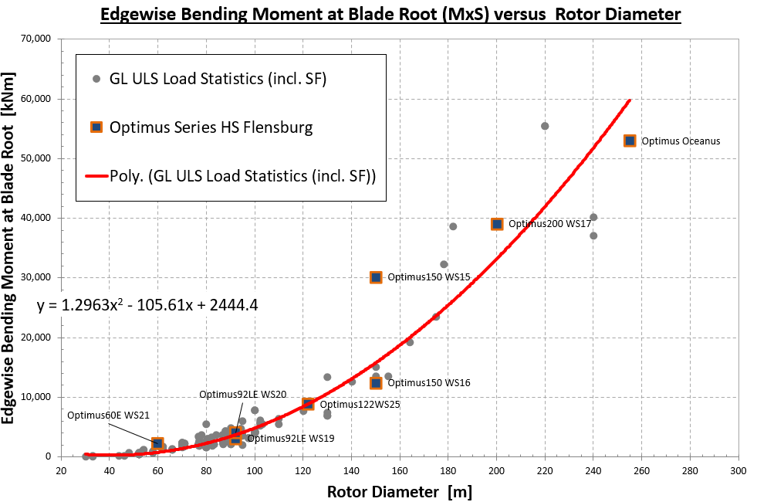
Estimated Extreme Loads for Optimus Syria

Slide 34
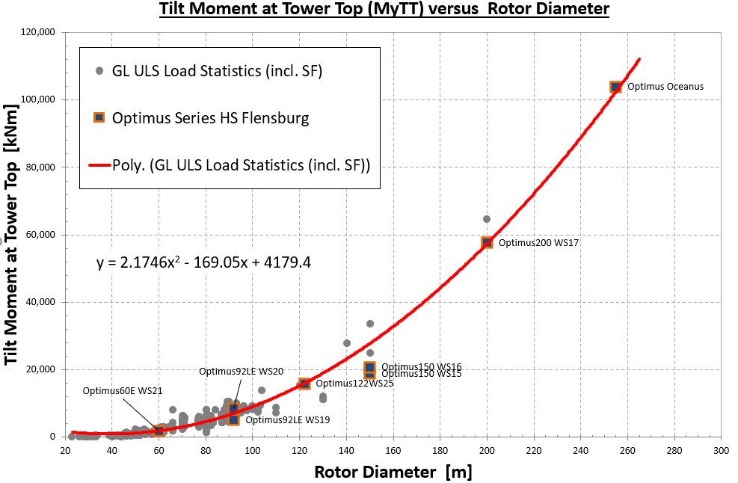
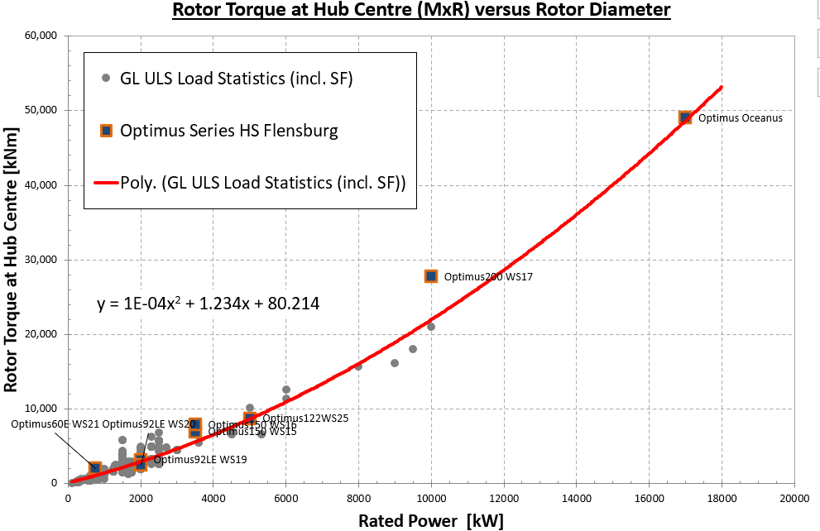
Estimated Extreme Loads for Optimus Syria

Slide 35
Estimated Extreme Loads for Optimus Syria
All values represent extreme loads (ULS) and already include the corresponding partial safety factors (γF).
 | Blade Edge moment | Blade Flap moment | Rotor thrust | Yaw Bearing Tilt moment | Rotor torque | Tower-bottom | Diameter | rated Power
 | kNm | kNm | kNm | kNm | kNm | kNm | m | KW
Optimus150 WS15 | 30,103 | 26,341 | 1,535 | 18,793 | 6,941 | 256,308 | 150 | 3,500
Optimus150 WS16 | 12,413 | 26,770 | 1,737 | 20,817 | 7,925 | 284,580 | 150 | 3,500
Optimus200 WS17 | 39,052 | 100,649 | 4,503 | 57,713 | 27,729 | 681,780 | 200 | 10,000
Optimus Oceanus | 52,998 | 116,570 | 4,872 | 103,990 | 49,073 | 1,189,800 | 255 | 17,000
Optimus92LE WS19 | 3,074 | 8,184 | 630 | 5,082 | 3,194 | 64,590 | 92 | 2,000
Optimus92LE WS20 | 4,070 | 7,495 | 764 | 8,432 | 2,471 | 86,020 | 92 | 2,000
Optimus60E WS21 | 2,204 | 1,872 | 304 | 1,708 | 2,005 | 28,567 | 60 | 750
Optimus Syria | 8,854 | 16,044 | 1,153 | 15,922 | 8,750 |  | 122 | 5,000

Slide 36
Tasks of the week
Feedback Controller Team
Task 1: Compile ROSCO.
Task 2: Do test runs with the reference models.

Slide 37
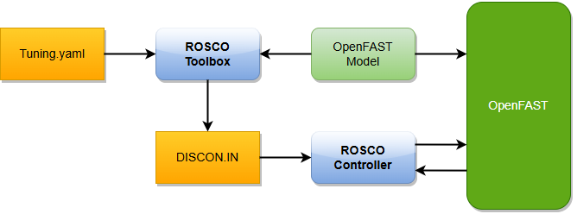
ROSCO – Reference Open-Source Controller
The Reference Open-Source Controller (ROSCO) is an open-source wind turbine controller developed by NREL.
It will be used for the Optimus Syria project.
It is compatible with OpenFAST.
It provides generator torque control and blade pitch control.
Controller features for the Optimus Syria
Generator and blade control with setpoint smoother and filter design
Tower damper
Coupling with Lidar assisted controller
Lidar-Boost: Increase of power when LAC is active
Description of the graph: Standard ROSCO workflow showing controller structure and interaction between OpenFAST and ROSCO. Citation of the sources: [1] Last date of access: 09/09/2025

Slide 38
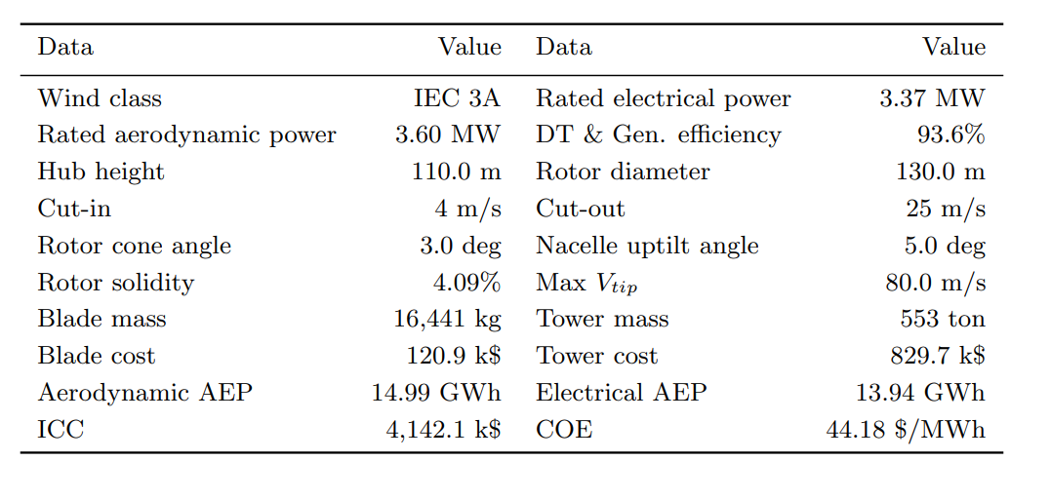
Model Proposal: IEA-3.4-130-RWT
The 3.4 MW Onshore RWT was developed under IEA Wind Task 37 to represent modern onshore wind turbine technology.
It is designed for class IIIA onshore sites.
Optimized for minimum cost of energy.
Description of the graph: Summary of the configuration of the land-based wind turbine.
Citation of the sources: [2] Last date of access: 09/09/2025

Slide 39
Content
Lidar Assisted Controller
Technical Insights
Consideration
Team Progress
Future Plans
Conclusions
Bibliography

Slide 40
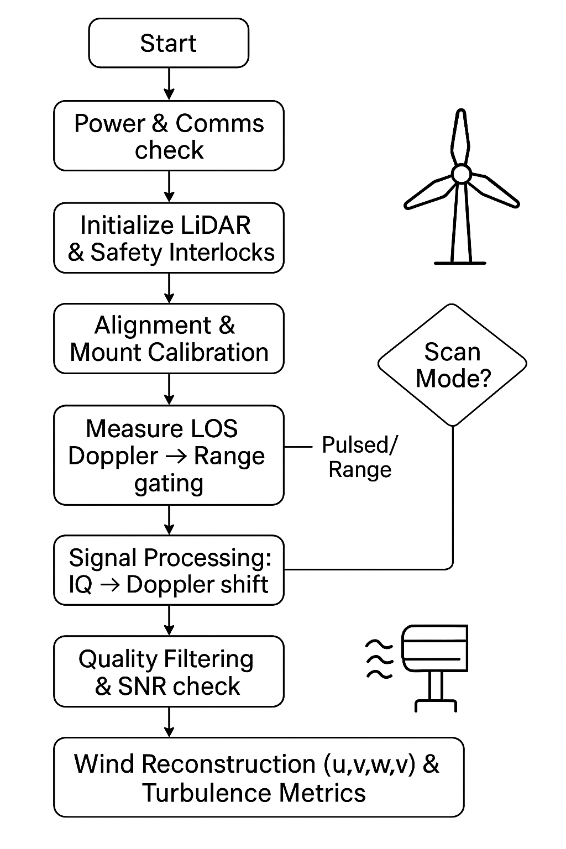
Technical Insights
Lidar-Assisted Control (LAC) can reduce turbine loads, improve pitch control response, and modestly increase energy capture or lifetime — especially using collective-pitch feedforward control.
Start with nacelle-mounted LiDAR + collective-pitch feedforward (most proven LAC method) to reduce turbine loads and extend lifetime.
Ensure dust/visibility mitigation and robust fallback control so turbines safely revert to baseline if LiDAR signals degrade.

Slide 41
Considerations
Dust conditions require LiDAR protection and reliable fallback control.
Grid instability needs smoother power output from LAC.
Account for access, site security, and spare parts supply chains. Consider remote diagnostics to reduce on-site visits.
Train local O&M teams on LiDAR calibration and control fallback procedures during project rollout.

Slide 42
Team Progress(Individual Progess)
Annika Gäthje
Matlab Intermediate Done
Python Basic Started
Fortran Basic Started
LiDAR Basic Started
Literature Files All Completed
Hesham Mahmoud
Matlab Basic Started
Python Basic Started
Fortran Basic Started
LiDAR Basic Started
Literature Files 1st File Completed
Md Aman
Matlab Intermediate Started
Python Basic Started
Fortran Basic Started
LiDAR Intermediated Started
Literature Files 1st File Completed
Midhun Kanichattu Venu
Matlab Intermediate Started
Python Intermediate Started
Fortran Basic Started
LiDAR Intermediated Started
Literature Files Completed

Slide 43
Team Progress(Weekly wise)
Week 1
Week 2
Setup meeting get familiar with each other. Make a road plan for team progress. Downloaded software and installed them.
Started learning with software’s basics like Matlab and Python. Started studying files given by professor. Meet with feedback control group.
Week 3
Week 4
Finished Basics of Matlab and Python. Installed Fortran Software and planned meeting with professor for further guidance.
Meet with professor. Started learning of basics of Fortran software. Also started intermediate of Matlab software which guided to us by professor. Started Simulation with Matlab.

Slide 44
Future Plans
Start Fortran implementation.
Enhance MATLAB/Python through applied tasks.
Finish literature reviews and identify research focus.
Analyze previous project data for control insights.
Develop and test LiDAR-based control strategies.

Slide 45
Conclusion
1. Gained basic to intermediate skills in MATLAB, Python, Fortran.
2. Developed Syrian conditions and simulate working with LiDAR.
3. Complete key tutorials and started reviewing the literature.
4. Reviewed past project files and related data.
5. Team is well-prepared for the next development phase.

Slide 46
Why Rotor Blade Design?
Rotor Blade Design
Rotor blades are heart of a wind turbine.
Shape, Material, and aerodynamics determine energy capture efficiency.
Global shift toward renewable energy, especially wind power, increases the importance of blade innvoation.
Rotor blade design improves turbine efficiency, durability, and cost-effectiveness.
This project applies engineering principles like aerodynamics, materials science, and structural analysis to support cleaner and more reliable wind energy systems.

Slide 47
Software Tools for Rotor Blade Design
FORTRAN
Used for computational analysis and custom coding.
Helps in implementing Blade Element Momentum (BEM) theory and aerodynamic equations.
Provides flexibility to test mathematical models for rotor blade performance.
QBlade
Open-source software specialized in wind turbine blade design and simulation.
Allows airfoil analysis, rotor design, and performance prediction.
Integrated with XFOIL for aerodynamic calculations.
Useful for validating our theoretical results and optimizing the blade geometry.

Slide 48
Workflow Chart
1. Project Initiation
2. Conceptual Design
3. Theoretical Analysis
4. Simulation & Modelling
5. Structural & Material Considerations
6. Optimization
7. Final Design & Documentation

Slide 49
Week 1 – Work Done
Tasks Completed:
Identified the software tools for the project: FORTRAN and QBlade.
Explored and tried basic functions of the software.
Studied last year’s project report to understand past approaches.
Reviewed research papers related to rotor blade design.
Attempted the activity assigned by the professor.
Challenges:
Could not complete the professor’s activity due to uncertainty about the next steps.
Need further guidance to proceed effectively.
Next Steps:
Clarify the activity requirements with the professor.
Start a structured plan for applying the software to rotor blade design.
Continue literature review and finalize the tools for simulation and analysis.

Slide 50
Rotor Blade Structures
Steps Planned during the
Project Phase
Reference –
5 MW/61.5m Wind Turbine Blade Reference Model by Brian R. Resor, Sandia National Laboratories, California, USA

Slide 51
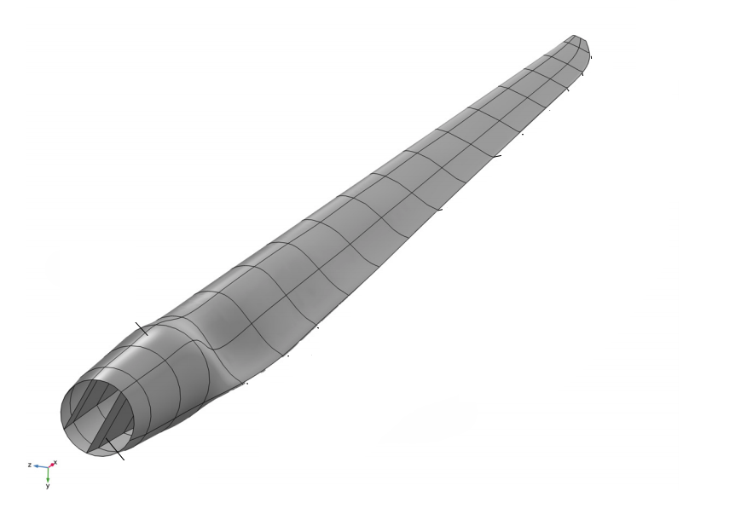
Step 1 - Define Blade Geometry
Use existing models (i.e. Brian Resor 5MW/61.5m, NREL 5MW) as reference models
Incorporate Air foil shapes, chord distribution, and blade length with help of Team Blade Aerodynamics
Adjust tip and root geometries considering structural requirements from other Teams
Ensure compatibility with manufacturing constraints with the current Industrial Standards

Slide 52
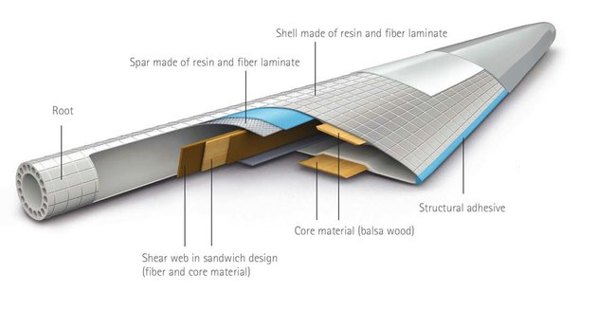
Step 2 – Material Selection
Choose materials based on strength-to-weight ratio by analysing using Softwares
Use material properties similar to those in proven models
Determine material layup strategies for skins, shear webs, spar caps
Incorporate safety factors as per IEC standards

Slide 53
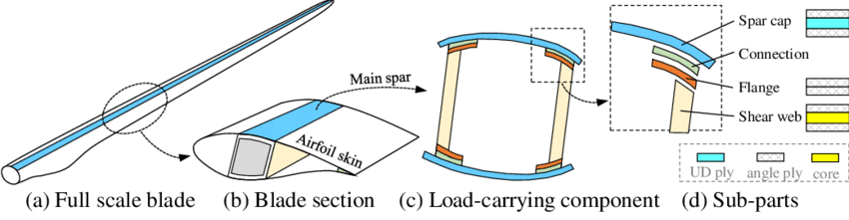
Step 3 – Structural Layout & Component Design
Design skin layups for aerodynamic surfaces
Configure shear webs and spar caps for load transfer
Optimize thickness and placement to resist buckling and fatigue
Define root hardware and connection details

Slide 54
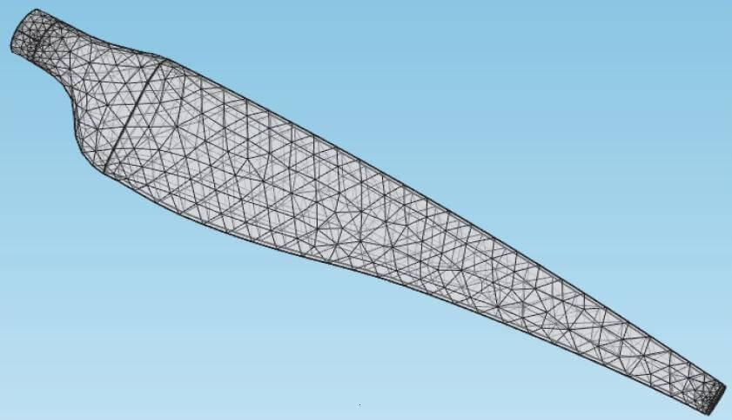
Step 4 – Finite Element Modelling
Develop detailed cross-sectional models of blade segments
Perform modal and static analyses
Validate structural integrity under expected loads
Use tools like NuMAD and ANSYS

Slide 55
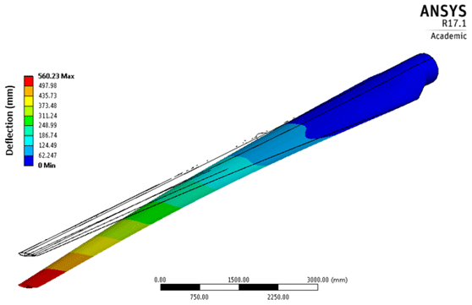
Step 5 – Load Analysis & Simulation
Apply design load cases based on IEC standards
Simulate extreme and normal operating conditions
Evaluate fatigue life, buckling safety, ultimate strength
Iteratively refine layup and design based on results

Slide 56

Step 6 – Performance Verification & Optimization
Check critical deflections and natural frequencies
Ensure tower clearance and safety margins
Adjust material distribution and structural elements
Confirm compliance with safety and durability criteria

Slide 57
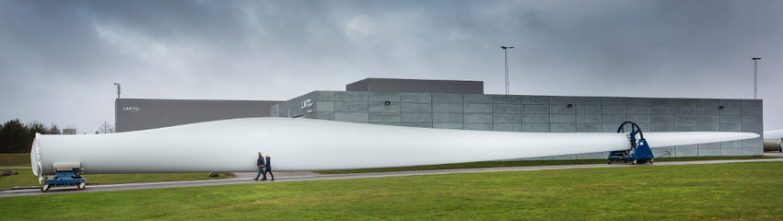
Step 7 – Final Design & Documentation
Compile detailed structural drawings and layups
Prepare analysis reports and validation results
Collaborate with manufacturing for feasibility
Prepare for further aerodynamic and control validations

Slide 58
Tasks of the week
Electrical Drive Train
Content
Week 1 : Initial Research & Setup
Initiated research on electrical market in Syria and neighboring countries. [1]
Gathered data on designing Generator, Convertors.
Collect information's from kickoff presentation slide and find out the duties of Electrical Drive Train team.
Studied generator types: PMSG, DFIG, synchronous generators.
Week 2 : Generator Studies
Reviewed paper for criteria for selecting Generator type. [2]
Collected data on the Cost: Economic considerations for energy production.
Performance: Rated power output, annual energy production, and efficiency in Syria. [3]
Technology: Synchronous vs. asynchronous generator.
Compared Generator types ( PMSG & DFIG)

Slide 59
Week 3 : Converter Studies
Studied different types of converters generally used in Wind Turbines, with focus on Syria.
Analyzed functions and classifications of converters in Wind Turbine Technology.
Studied classification and choice of generator-side converter systems. [4]
Started studying MATLAB software and applications.
Outcome: Completed converter analysis and initiated MATLAB learning for simulations.
Week 4 : Generator Research & MATLAB Study
Studied Wind turbine drivetrains: state-of-the-art technologies and future development trends.
Collecting the data’s and doing research on the type of generator which we can use for this project.
Collected data for reactive power capabilities of different Generators.
…

Slide 60
Week 5 : Generator Finalization & Converter Study
Finalized generator type for Optimus Syria Project
Studied converter protection, maintenance, and reliability. [5]
Challenges:
Ensuring chosen generator meets project requirements
Outcomes:
Shortlisted generator type
Week 6 : Concept Finalization
Selected PMSG type generator for Optimus Syria project.
Researched types of converters suitable for the design.

Slide 61
Our Recommendation: PMSG for the Optimus Syria
Why PMSG is the Better Choice:
Reliability is Critical: Given the challenges with local support and part availability in Syria, the PMSG's higher reliability and lower maintenance needs are paramount. This is a crucial factor, especially in a climate with high heat and dust.
Adaptability to Weak Grids: The Syrian electrical infrastructure is facing reconstruction , and the grid is weak. The PMSG's excellent grid control makes it a robust choice that can handle these conditions effectively.
Efficiency and Durability: PMSG generators meet the preferred efficiency standard of over 90% for grid-connected systems. Their durable design is well-suited to the local climate.
Long-Term Financial Viability: While the initial cost may be higher , the long-term benefits of reduced maintenance and higher efficiency will lead to a more sustainable and economically sound project.

Slide 62
Tasks and Results of the last weeks
Grid Code Development
Content
Grid Code – Key Aspects
Research about the grid infrustructure
Deeper insights to international and national standards of Grid Codes
Comparision of German and Syrian grid code
Syrian grid problems
Outlook

Slide 63
Grid Code – Key Aspects
Defines international and national standards for grid connections
Specifies voltage and frequency requirements
Sets grid connection conditions
Includes control energy and reactive power specifications
Defines fault ride-through behavior
Outlines communication and reporting obligations
[1]

Slide 64
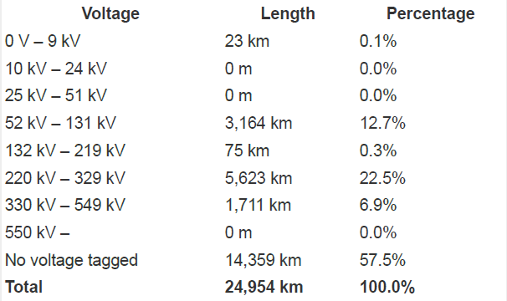
Grid infrastructure
Map of Syria’s electricity infrastructure
Renewables in Installed Capacity
Total share: 20,1 %
Wind: 0.1 % (≈ 11 MW)
Two substantially sized wind farm are existing close to border in Israel
Collected voltage-km chart
[5]

Slide 65
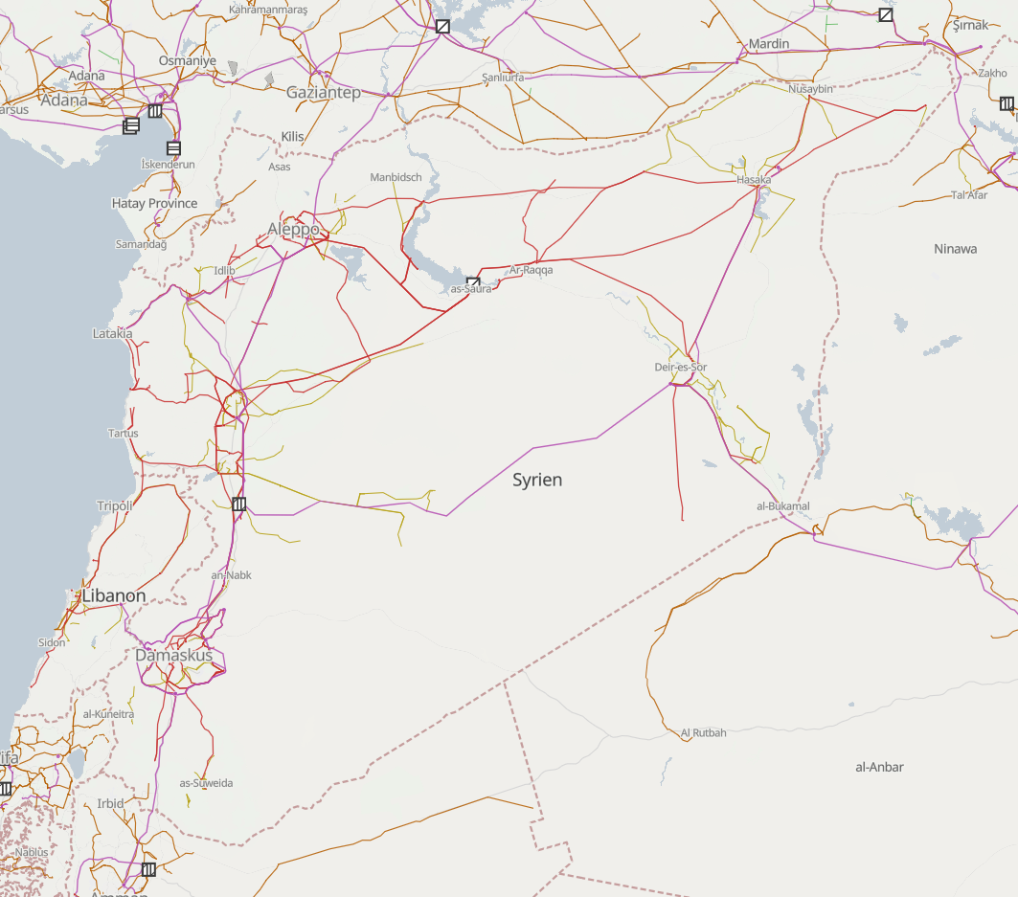
Infrastructure map
[5]

Slide 66
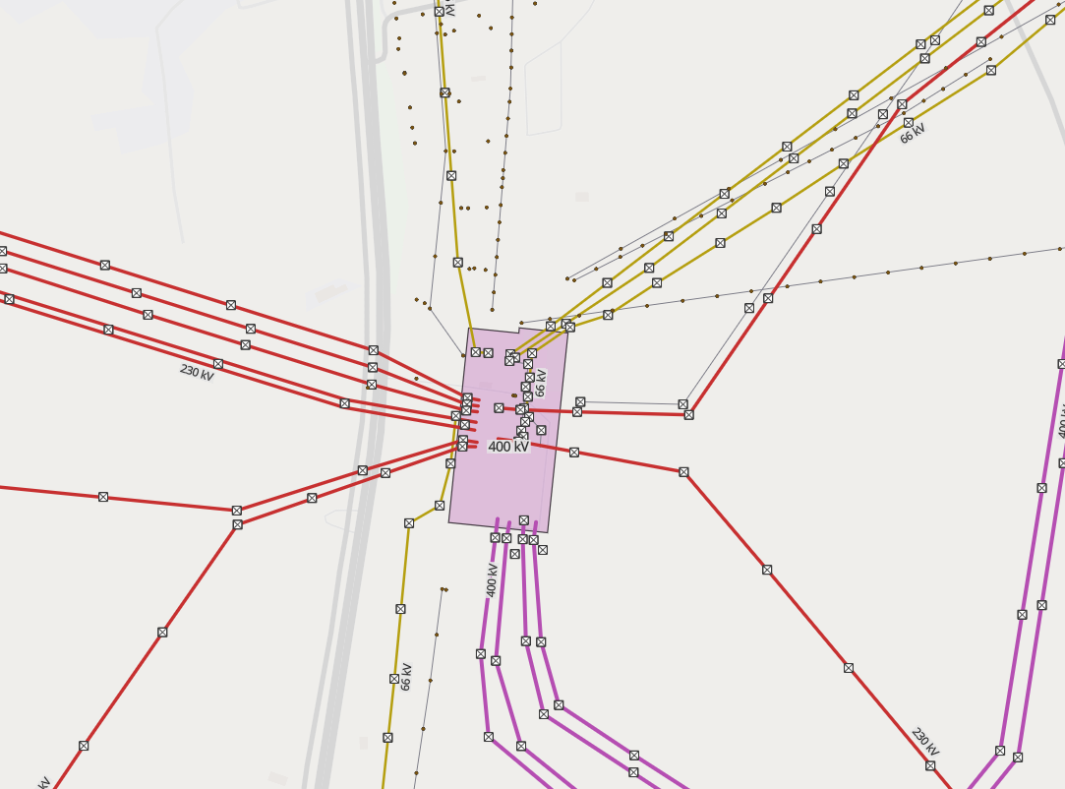
Infrastructure map
Substation
Grid Tower(s)
[5]

Slide 67
DNV-GL standards
Since, IEC 61400-1 is not accessible, DNV-GL is choosen as it is mostly the same
Chapter 8 in the DNV-GL IV I Guideline for the Certification of Wind Turbines Edition 2010 were studied
Standard turbine requirements noted
Mainly relevant after design, during part selection
[2]

Slide 68
Grid Code requirements from the PETE
PETE (Public Establishment for Transmission of Electricity)
Paper: Transmission Grid Code (2014)
Content
General Conditions (GC)
Planning Code (PC)
Connection Conditions (CC)
Operating Code (OC1 – OC11)
Scheduling and Dispatch Code (SDC1 – SDC3)
Metering Code (MC)
[3]

Slide 69
Grid Code requirements from the PETE
Voltage levels: 0.4-400 kV
Feed-in limit (20 kV grid): up to 5 MW
DC Injection: ≤ 0.25 % of rated current
Voltage Deviation: +- 3% from nominal
Individual Harmonics (Point of Connection):
MV (20 kV): 2.5 %
HV (66 kV): 2.0 %
[3], [4]

Slide 70
Comparison german and syrian Grid Code
 | Syria | Germany
Grid frequency | 50 Hz | 50 Hz
frequency working range | 47.5 < X < 51.5 Hz | 47.5 < X < 51.5 Hz
Minimum power factor for WT | 0,98 | 0,95
Maximum amount of renewable energy systems in a certain area | 30 % | -
[4]

Slide 71
Syrian grid problems
War damage
Often power outages
Inefficient
Still heavily reliant on fossil fuels for energy production
[6]

Slide 72
Outlook
Compare the older designs of circuits and control systems of asynchronous to the latest synchronous generator control systems as provided from S. Heier’s textbook
Prepare a checklist of data required from other teams
Design the circuits and control systems and simulate based on the exact details from other teams
Browse brochures for components compliant with IEC or DNV-GL standards to prepare the bill of materials (BOM) and cost estimate
Getting more into Simulink, starting also with Power Factory

Slide 73
Objectives
Rotor Hub And Pitch System
Design of the Hub
Selection of Pitch system
Design of a pitch system
Design of spinner
Design of pitch-bearing

Slide 74
Rotor Hub
The rotor hub is defined as the component that hosts the blades of a wind turbine, coupling them to the slow-speed shaft, and is designed to withstand the forces and moments exerted by the blades while allowing for independent control of their angle of attack.
The rotor hub is the component that usually holds the blades and connects them to the main shaft of the wind machine.
It is a key component not only because it holds the blades in their proper position for maximum aerodynamic efficiency, it also rotates to drive the generator.
Hubs come in many different shapes and configurations, mostly dependent on the type of generator used and the design of the rotor blades.
Now a days Hubs are generally covered by Spinner.

Slide 75
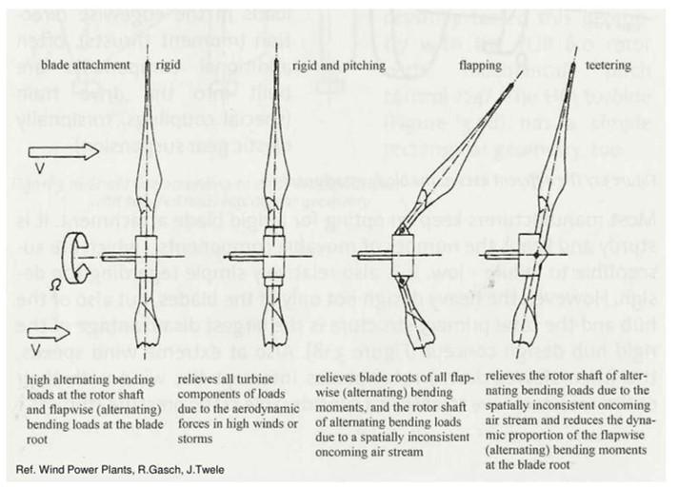
Types of Hub
Rigid hubs (All major parts in a fixed position relative to main shaft)
Teetering hubs (Used for two-bladed turbine and also reduce loads due to aerodynamic imbalances or loads due to dynamic effects from rotation of the rotor or yawing of the turbine)
Hubs for Hinged blades (It’s in some ways a cross between a rigid hub and a teetering hub. It is basically a rigid hub with ‘hinges’ for the blades)

Slide 76
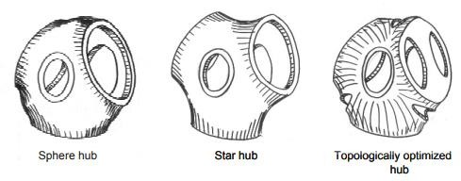
Shapes of Hub

Slide 77
Design criteria
Hub radius (distance between axis of rotation and blade flange)
Connection to shaft (flange or locking ring)
Possibility to adjust pitch angle (slotted holes, marks and scale, locating pins)
Need of internal space to accommodate pitch control mechanism.
Accessibility of bolt heads (from inside the hub, or external flange).
Weight
Cost
Ease of manufacturing and assembly

Slide 78
Manufacturing way of the Hub
There are various manufacturing processes for a rigid hub with pitch including:
Welding
Forging
Casting
For smaller turbines, all three manufacturing methods are used.
For prototypes occasionally using welded fixes.
For multi-megawatt turbines, cast hubs are often utilized.

Slide 79
Pitch System
What is pitch control system in wind turbine?
-Pitch control is the technology used to operate and control the angle of the blades in a wind turbine.
-The pitch system is a closed loop drive system. The turbine main controller calculates the required pitch angle from a set of conditions, such as wind speed, generator speed and power production.
-A wind turbine's pitch control system adjusts the angle of the rotor blades to regulate power generation and ensure the turbine's safety

Slide 80
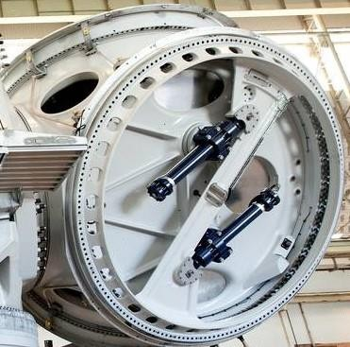
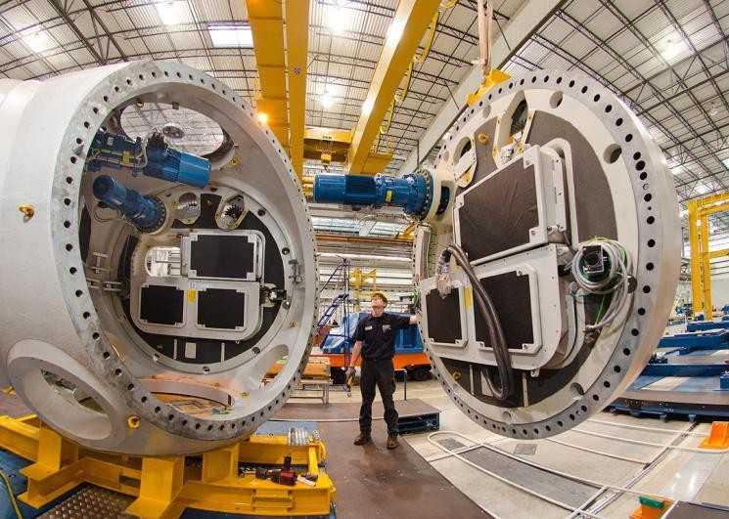
Types of Pitch Control System
Hydraulic Pitch Control System
Electric Pitch Control System
-Internal gear
-External gear

Slide 81
Content Overview
Rotor Bearing System
Introduction
Components to Design and its consideration
Types of Drivetrain System
Drivetrain System Shortlisted for WEC Syria
Types Rotor Bearing
References

Slide 82
Introduction
Rotor Bearing System (RBS) supports and allows rotation of the wind turbine rotor.
It transfers mechanical loads safely to the structure.
It’s part of the drivetrain: Rotor → Shaft → Bearings → Coupling → Gearbox → Generator.
Operates under harsh environmental conditions: temperature extremes, dust, humidity especially in SYRIA

Slide 83
Components to Design in RBS
Main Shaft – Connects rotor to gearbox
Bearings – Allow rotation, support loads
Bearing Housing – Encloses the bearing
Coupling – Transfers torque from shaft to gearbox
Flanges – Provide bolted connection interfaces
Rotor lock – ensures rotor locking under wind loads even if the brake systems fails

Slide 84
Design Considerations
Standards: They ensure safety, reliability, and compatibility. They give rules for how strong, durable, or precise a part must be.
Materials:
High fatigue strength to handle variable loads.
Resistance to corrosion (humid area).
Availability and cost-efficient
DIN EN 1563:2012-03 to select the suitable material specifications
Design Requirements:
Mainly life span ......(Min of 20 years)
Must handle: Deformations of rotor shaft, Angular misalignments, Standstill loads, Harsh environmental exposure
Shaft,Housing,Rotor locking disk | EN-GJS-***-** Cast iron
Rotor Bearing | Steel

Slide 85
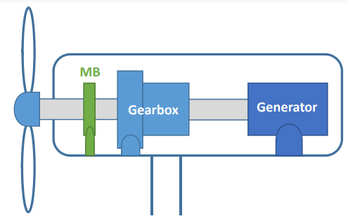
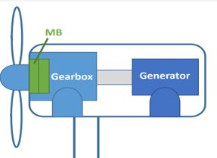
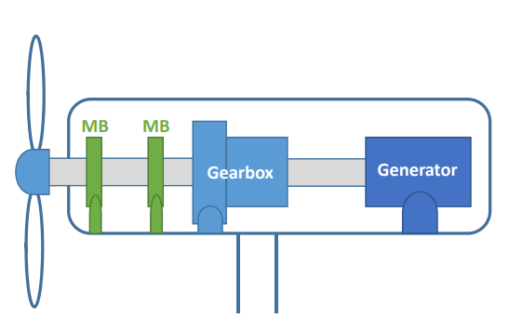
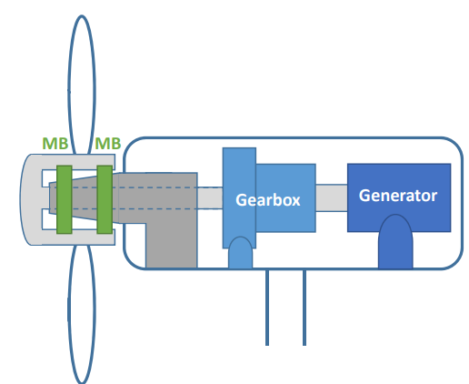
Types of Drivetrain System
Semi-integrated
Integrated
Modular
Axle Pin Mounting

Slide 86
Drivetrain system shortlisted
1. Integrated rotor bearing system combine the main bearing and other structural elements (like shaft or housing) into a single, optimised unit. You may have chosen this because:
Technical Advantages:
Compact design: Reduces the number of parts, leading to better alignment and load transfer.
Higher reliability: Fewer joints and interfaces mean lower chances of wear, misalignment, or failure.
Lower maintenance: Ideal for remote areas in Syria where frequent service might not be possible.
Improved performance: Optimised for stiffness, load paths, and fatigue life, which is crucial for high wind variations and turbulent inflow conditions.
Contextual Fit for Syria:
Energy reliability is critical: Syria has unstable energy infrastructure; integrated systems reduce the risk of downtime.
Difficult access to spare parts or skilled labour: Integrated units reduce the complexity of repairs and replacements.
Harsh environmental conditions (dust, heat): Fewer seals and joints help resist contamination and reduce lubrication problems.

Slide 87
2. Modular rotor bearing system use standardized parts that can be assembled, replaced, or scaled as needed. You may have suggested this because:
Technical Advantages:
Ease of transport and installation: Especially useful in areas where road or crane access is limited.
Flexibility in upgrades: Easier to scale the system or replace damaged modules without disturbing the whole structure.
Customizability: Bearings and housing can be adapted for specific rotor sizes or load conditions.
Contextual Fit for Syria:
Repairable and replaceable: In case of damage from wear, grid instability, or weather, parts can be swapped with ease.
Local assembly possible: Reduces need for specialized manufacturing and can support local job creation.
Cost-effective for smaller or distributed wind farms: Syria may need many smaller, local wind installations rather than one giant farm.

Slide 88
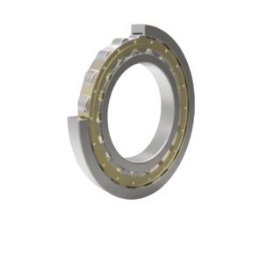
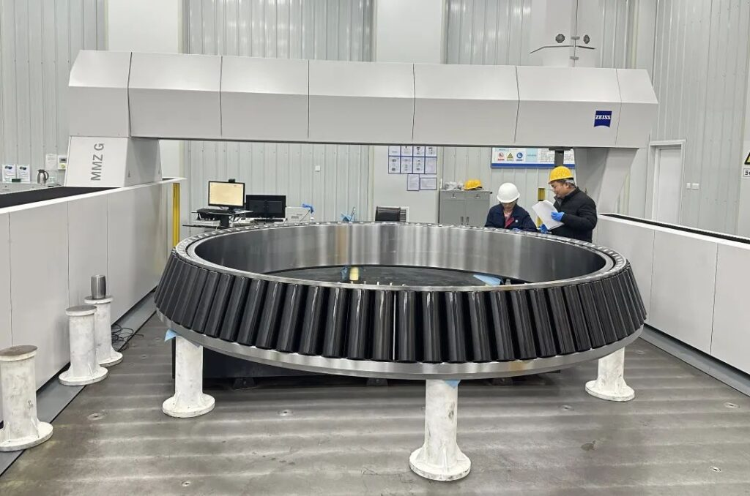
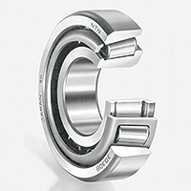
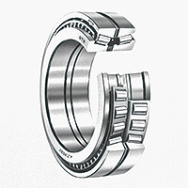
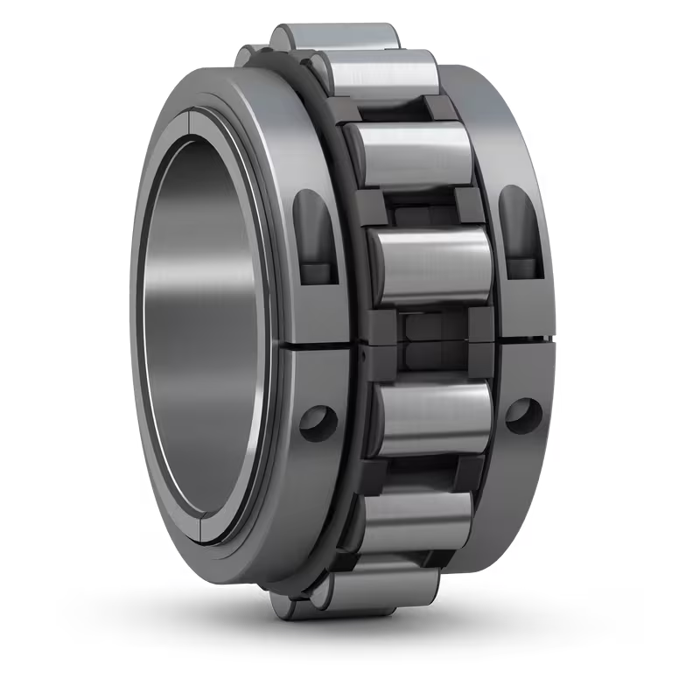
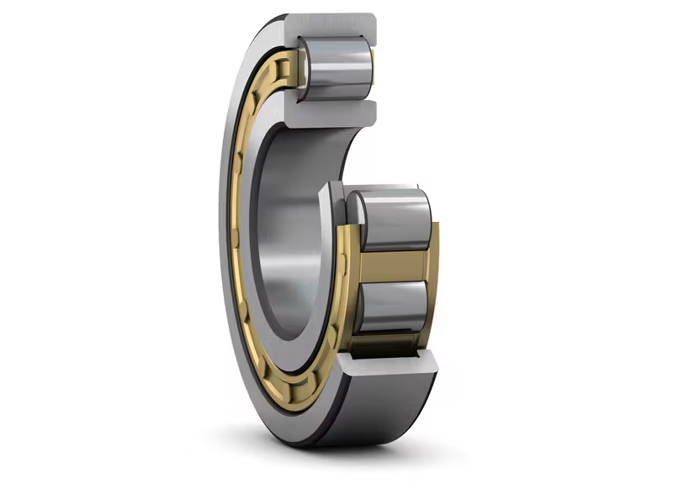
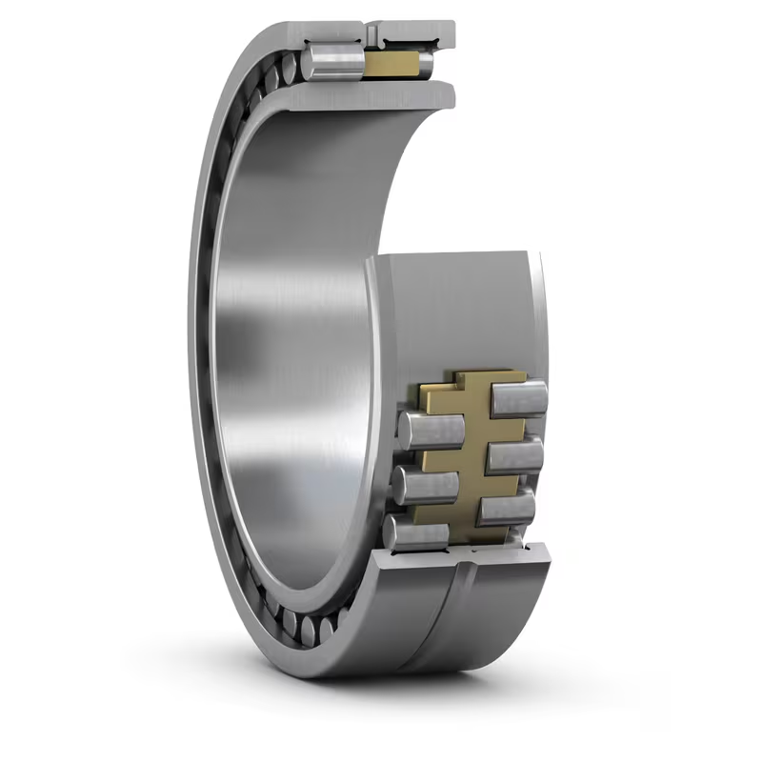
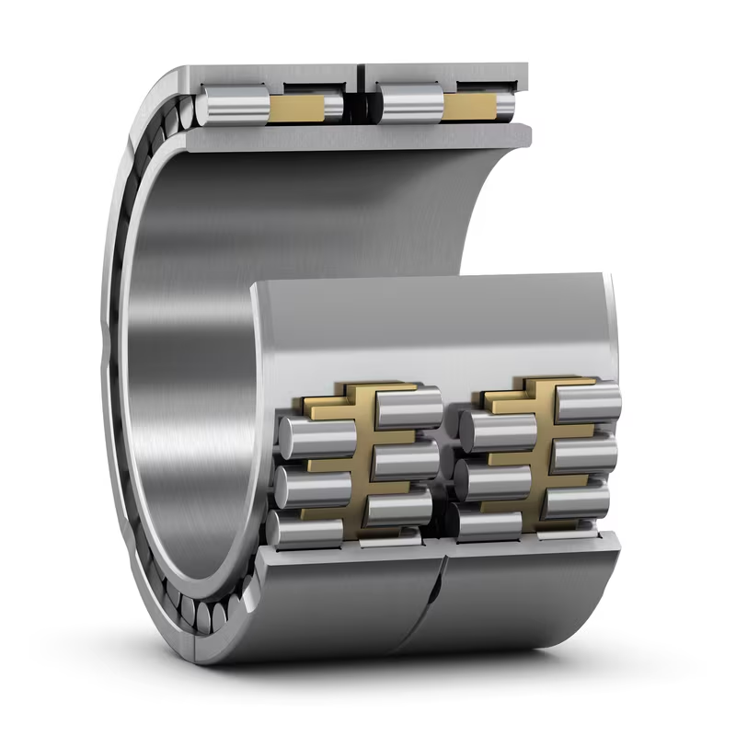
Types of Rotor Bearing
Cylindrical Roller Bearing (CRB)
High Radial Load Capacity
Low Friction Performance
High Precision
Tapered Roller Bearing (TRB)
Handles combined radial and axial loads.
Often used in two-bearing designs.
Often used as non-locating bearing in double designs.
Source-SKF

Slide 89
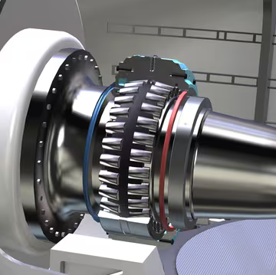




Double Row Tapered Roller Bearing (DRTRB)
Spherical Roller Bearing (SRB)
High stiffness and compact design.
Suitable for integrated bearing housings.
Simultaneously withstands High Radial and Axial Loads
Self-Aligning Capability
Optimized Lubrication Design
Common in single-bearing designs.

Slide 90


Toroidal Roller Bearing (CARB)
Combines misalignment and axial displacement tolerance.
Have one row of long, slightly barrel-shaped symmetrical rollers and torus-shaped raceway profiles .
They are non-locating bearings and accommodate exclusively radial loads.
often used to replace the non-locating spherical roller bearing in a locating/non-locating bearing arrangement.

Slide 91
Arrangements of Bearing
Arrangement Style | Description | Use Case
Floating | One bearing allows axial movement | Compensates for thermal expansion
Locating/Non-locating | One bearing fixed axially, other allows movement | Common in modular setups
Adjusted (O/X) | Bearings preloaded in face-to-face (X) or back-to-back (O) configuration | High precision, used in tapered or angular contact bearings

Slide 92
Bearing Short Listed
Selected Configuration
Pre-loaded tapered roller bearing in O-arrangement
2. Spherical Bearing

Slide 93
Supplier Details
Supplier identification in Syria is under process, but none have been located to date.
In Husum Wind we got in contact with ZF and Thyssenkrupp Roethe erde and they told to help us if needed.

Slide 94
Objectives
Gearbox, Brake, Coupling
Design of the Gearbox
Selection of Brake system
Design of Coupling

Slide 95
Gearbox
Main Objective:
Introduction
Research and market analysis
Standards and guidelines
Dimensioning of gears
Drawings
Calculation

Slide 96
Gearbox
Research on relevant standards and guidelines
IEC 61400-1:2019, Wind energy generation systems —Part 1: Design requirements
• IEC 61400-4:2012, Wind turbines —Part 4: Design requirements for wind turbine gearboxes
• ISO 6336-2:2019, Calculation of load capacity of spur and helical gears —Part 2: Calculation of surface durability (pitting)
• ISO 6336-3:2019, Calculation of load capacity of spur and helical gears —Part 3: Calculation of tooth bending strength
• ISO/TS 6336-4:2019, Calculation of load capacity of spur and helical gears —Part 4: Calculation of tooth flank fracture load capacity
• VDMA Specification 23903, Basic design requirements for plain bearings in main gearboxes of wind turbines
• VDMA Specification 23904, Reliability assessment for wind energy gearboxes

Slide 97
Gearbox
Semi-integrated design (so-called 3-point-suspension) Company in Germany which is using this kind of concept. a. Senvion b. Vestas c. Siemens d. Nordex e. GE
• Why ?
rotor bearing system is partly integrated in the gearbox.
The fixed bearing is connected to the machine bed, the floating bearing is part of the gearbox.
rotor loads (forces and moments) are transferred through the housing of the gearbox into the machine bed. separated 2nd bearing housing is not required anymore(as per our decision this is the main advantage of this drive train system using for Syria project 2025-26 (But still needs to research)……………………

Slide 98







Gearbox
Suppliers in the market:

Slide 99
Rotor Brake
Main Objective:
Introduction
Research and market analysis
Standards and guidelines
Dimensioning of brake
Drawings
Calculation

Slide 100


Rotor Brake
Fixed caliper brake (disk brake) is a typical hydraulic service brake used on the low torque side. All features of these hydraulic brakes are designed to operate reliably under adverse ambient conditions while generating low operating expenses.
Floating Caliper Design: The ability of the caliper to slide on the guide pins is crucial for ensuring proper and even braking force application, even if the rotor is slightly misaligned. This floating action also helps to distribute the braking force evenly across the brake pad, reducing wear and tear.
Applications in Wind Turbines: Rotor brakes (also known as fast speed dynamic brakes) are used to control over-speed conditions, preventing the turbine blades from rotating too fast in emergency situations or during parking. They can be mounted on either the low-speed shaft (rotor) or the high-speed shaft (generator). Floating caliper brakes are particularly useful in wind turbines due to their compact design and self-aligning properties, especially in applications where space is limited. They are also used in yaw brakes, which hold the nacelle (the housing at the top of the tower that contains the generator and other components) in a fixed position.

Slide 101



Brake system
Suppliers in the market:
ICP WIND
Svendborg Brakes
KTR
Stuwe

Slide 102
Coupling
Main Objective:
Introduction
Research and market analysis
Standards and guidelines
Dimensioning of coupling
Drawings
Calculation
Pros
Control and Safety
Reduced Gearbox Stress
Cons
Energy Loss
High Cost
Main Objectives:
To handle high torque, Minimize shock loads, and compensate misalignments between the rotor shaft and the gear box

Slide 103


Jaure
JHC couplings
Jaure hydraulic shrink coupling
Easier installation
Can withstand high shock loads
Leakage risk
High pressure oil pump system is needed
Source: https://www.regalrexnord.com/brands/jaure/wind-power-drives
103

Slide 104

Flender
ARPEX GIGA wind coupling
This coupling can transmit torques of up to 12 MNm.
maintenance-free
compensate for axial, angular and radial misalignments.
A lot of Mechanical components
Source: https://www.flender.com/Produkte/Kupplungen/ARPEX-Windkupplungen/p/ATN09001
104

Slide 105

Geislinger
COMPOWIND Coupling
An innovative concept of fatigue-resistant and maintenance-free fiber composite membranes. With more than 90% reduction of rotor non-torque loads.
Fatigue-resistant
Maintenance-free
No aging, no wear, resistant to heat, frost, and saltwater
Diameters up to 3.5 m
Weight-saving design
Long life cycle
Source: https://www.geislinger.com/en/products/product/compowind-coupling/
105

Slide 106
Got some idea about from the internet and some website that is Winenergy group of company which origin of the German possible to provide in Syria because they have large production of gearbox which can gives good amount of work output and higher generation rates.
Enercon company is also leading for supplies in Syrian region.
ZF wind power Antwerpen also who is responsible to provide in this country
ZF wind power and giants company like Siemens and flander 40-50% stockholder for this project for suppliers.
( Above companies are located in European region mostly are capable enough)
Goldwind and Dongfang is also could become leading for suppliers of gearbox,brake,coupling ( Asian region and these companies located in china )
Research on previous year documents and got information about gearbox,brake,coupling
Research on appropriate drive train concept and gearbox
Research on standards and guild line and benchmarks for gearbox,brake,coupling
Research on Syrian market and know about suppliers

Slide 107
Objectives
Machine Bed:
Variants
Interfaces
Design & Calculations
Yaw System:
Variants
Specification & Calculations
Control and wear considerations
Shared Tasks:
Supplier base analysis
Benchmarking and concept definition

Slide 108
Week 1: Kickoff & Setup
Tasks:
Studied kickoff slides (team role, deliverables).
Downloaded software (Solidworks, Ansys, Matlab)
Obtained last year’s documentation.
Reviewed IEC 61400 & DNV standards for nacelle/yaw.
Outcome:
Clear definition of scope.
Set up file-sharing (GitHub, documentation).

Slide 109
Week 2: Literature Review
Tasks:
Reviewed papers on designing. (Design, Analysis, and Development of a nacelle main load frame for a 500KW wind turbine.) [1].
On yaw systems, Artificial Neural Network-Based Reinforcement Learning for Wind Turbine Yaw Control. [2].
Studied state-of-the-art hydraulic yaw systems for wind turbines. [3].
Research papers for a better understanding of nacelle tower foundation, Optimization of the Yaw Control Error of Wind Turbine. [5] [6].

Slide 110
Week 2: Literature Review Continue
Collected references on machine bed concepts.
Compared cast vs welded bedplates.
Outcome:
Selected casted bedplate as likely concept for Syria (Stiffness + damping).
Noted yaw optimization methods.

Slide 111
Week 3: Concept Benchmarking
Tasks:
Reviewed yaw system concepts and design methods. [4]
Studied suppliers for yaw bearings & drives.
Drafted comparison table (electric vs hydraulic yaw drives).
Outcome:
Direction: Electrical Yaw Drives
Casted bedplate confirmed as baseline.

Slide 112
Week 4: Context Research
Tasks:
Analyzed Syrian context: hot/dusty climate from Github (details provided of each zone), weak grids, transport issues.
Connected with the Loads & Dynamics team for expected load transfer.
Checked with Wind Speed to Height (Peak wind speed Max. and Min. throughout the year. (From Github)
Outcome:
Constraints point to casted bedplate, high-temp lubrication, robust yaw brakes.
Next: continue detailed research before starting CAD modelling later.

Slide 113
Challenges & Next Steps
Need load cases from the Loads & Dynamics team.
Got a data table.
Next tasks:
Wait for load case definitions (from the Loads team).
Continue literature & supplier research.
Prepare simple comparison tables for the report.

Slide 114
Conclusion
First 4 weeks:
We are on track for gradual progress.
Detailed design (CAD/FEM) will start sooner in the semester.
Setup
1
Literature Review
2
Concept Benchmarking
3
Context Research
4

Slide 115
Data base for the Tower Structure
Tower Structure
Turbine Size:
Power: 5 MW
Hub Height: 100 m
Environmental Data:
Wind Class II
Soil conditions: Sand or Rock
Location: Syria

Slide 116
Market availability & Existing wind Turbine
Tubular steel tower
Available Hub high
100 – 140 m
No. available suppliers
11 (Turkey, China, Europe)
Suitability for Syria
Most common choice. Good quality, fast delivery if port access & wide roads are available
Concrete Cast-in-situ
Available Hub high
100 – 120 m (custom)
No. available suppliers
Local contractor + slipform system
Suitability for Syria
Best for remote or mountainous sites. No need to transport large sections, only bulk materials.
Concrete precast tower
Available Hub high
100 – 120 m (custom)
No. available suppliers
Limited global suppliers
Suitability for Syria
Heavy transport required, may be challenging and costly to deliver to Syrian sites.
Lattice Steel tower
Available Hub high
Up to ~100 m
No. available suppliers
Few suppliers worldwide
Suitability for Syria
Lightweight and easy to transport but needs more maintenance
Timber tower
Available Hub high
Up to ~100 m No. available suppliers
Very few suppliers worldwide (limited market technology, but growing market) Suitability for Syria
Requires careful protection against moisture, insects, and fire

Slide 117
SWOT Analysis
Structure types
Tubular steel
Concrete Cast-in-situ
Concrete precast
Lattice Steel tower
Timber tower

Slide 118
SWOT Analysis for Tubular tower
Proven Technology: Widely used globally for 100 m hub height turbines, high reliability.
High Structural Strength: Good performance for large rotor diameters and high wind loads Long Lifetime: Low maintenance needs compared to lattice or hybrid towers
Regional Suppliers: Proximity to Turkey and Middle East suppliers reduces manufacturing lead time
Strengths
Weaknesses
High Initial Cost: Steel price volatility can significantly affect CAPEX . Transport Challenges: Oversized sections (up to 30+ m length, 4–5 m diameter) require wide roads and heavy-duty trucks – can be difficult in remote sites.
Dependency on Imports: No local tower manufacturing in Syria → exposure to currency fluctuations and import regulations.
SWOT
Renewable Energy Expansion: Syria has strong wind potential in coastal and mountain regions, creating opportunities for new projects. Local Assembly Potential: Possibility to develop local welding/painting facilities to reduce import costs in the future.
Government & International Support: Potential funding from international organizations for renewable energy reconstruction projects.
Opportunities
Threats
Logistics Risks: Border closures, port access issues, or road infrastructure damage can delay tower delivery.
Competing Tower Technologies: Cast-in-situ concrete towers may become cheaper and easier to implement locally.
Steel Price Fluctuations: Global market volatility can increase project costs unexpectedly.

Slide 119
SWOT Analysis for Concrete Cast-in-Situ Tower
Local Material Availability: Cement, aggregates, and rebar can be sourced locally, reducing import dependency.
No Need for Oversized Transport: Tower is built on-site → avoids challenges of moving large sections on narrow or damaged roads.
Durability & Long Life: Good resistance to corrosion and low maintenance needs in harsh climates Flexibility in Height: Can be customized easily for required hub height without special factory tooling
Strengths
Weaknesses
Longer Construction Time: Slipform casting takes several weeks of continuous work.
Need for Skilled Labor & Equipment: Requires experienced teams and specialized formwork systems.
Quality Control Risk: Poor curing or bad concrete mix can affect tower integrity if site supervision is weak.
Higher Upfront Mobilization: Need to mobilize formwork, cranes, batching plants to remote site.
SWOT
Job Creation: Uses local workforce, boosting local economy Lower Long-Term Costs: Potentially cheaper than imported steel towers, especially with high global steel prices.
Support for Local Industry: Encourages development of local concrete construction expertise
International Funding Potential: Reconstruction & renewable energy programs may support local material solutions.
Opportunities
Threats
Security Risks: Interruptions during multi-week construction period can delay work Weather Dependence: Continuous slipform process sensitive to rain, temperature changes Competition from Steel Towers: If steel prices drop, steel towers may become cheaper and faster to install.
Supply Chain Risks: Shortages of cement, aggregates, or fuel can delay casting process

Slide 120
SWOT Analysis for Concrete precast Tower
High Quality Control: Precast segments are produced in factory under controlled conditions → consistent strength and durability.
Fast On-Site Assembly: Once segments are delivered, tower can be assembled relatively quickly Durability: Excellent resistance to corrosion → very low maintenance over lifetime Long Service Life: Comparable or better than steel towers in harsh environmental conditions
Strengths
Weaknesses
Heavy Transport Required: Segments are very heavy and bulky → requires wide roads, special trailers, and strong cranes.
High Mobilization Costs: If no local precast factory, segments must be imported or factory built near site.
Limited Local Capacity: Syria may not have large-scale precast facilities for tall towers.
Logistics Complexity: Each segment must arrive on time for erection schedule, risk of delays
SWOT
Local Industry Development: Potential to set up precast plant locally for wind projects → long-term benefit. Lower Long-Term O&M Cost: Very low corrosion risk → reduces maintenance budget.
Good for Coastal/Moist Areas: Concrete performance is better in saline environments compared to unprotected steel.
International Partnership: Opportunity to partner with experienced precast suppliers from Turkey or Europe.
Supply Chain Vulnerability: Cement or reinforcement shortages can delay production High Transportation Cost: Especially critical in mountainous areas or where infrastructure is damaged Political / Border Delays: Customs or port delays can stall delivery of large segments Competition from Cast-in-Situ: Cast-in-situ may be cheaper and avoid transport problems
Opportunities
Threats

Slide 121
SWOT Analysis for Lattice steel Tower
Lightweight Structure: Uses less steel compared to tubular tower → lower material cost. Easy transport: Sections are small and can be transported on regular trucks, ideal for remote/mountainous areas with narrow roads. Lower Foundation Loads: Reduced overall weight means smaller and cheaper foundations. Proven for Small/Medium Turbines: Used globally where cost optimization is critical.
Strengths
Weaknesses
High Maintenance: Many bolted connections → regular inspection and tightening needed. Noise Amplification: Can slightly increase aerodynamic noise due to lattice members. Limited for Very Large Turbines: Not ideal for >3 MW turbines or very large rotor diameters.
SWOT
Local Fabrication: Can be produced in local steel workshops with basic welding/bolting capability → supports local industry.
Low Transport Cost: Advantage in areas with weak infrastructure (roads/bridges). Lower CAPEX: Can be cheaper than tubular tower if steel prices are high. Rapid Deployment: Fabrication and erection can be done in parallel with site prep.
Community Resistance: Visual and noise concerns may reduce public acceptance, especially near populated areas. Corrosion Risk: Open members exposed to weather need good galvanization → risk of corrosion if maintenance neglected.
Competition from Tubular Towers: OEMs may prefer tubular towers for large turbines. Political & Security Risks: More frequent maintenance visits might be challenging in unstable regions.
Opportunities
Threats

Slide 122
SWOT Analysis for Timber Tower
Sustainable Material: Wood is renewable → much lower CO₂ footprint compared to steel or concrete. Lightweight: Reduces foundation loads and simplifies transport. Prefabrication: Segments can be produced off-site and assembled quickly → reduces on-site construction time.
Good Fatigue Performance: Laminated wood can handle cyclic loading well if designed properly.
Strengths
Weaknesses
Very Limited Local Experience: No established timber tower manufacturing in Syria. Moisture Protection Required: Needs special surface treatment to resist humidity, rain, and UV. Fire Resistance Concerns: Requires careful fire protection design and certification. High Initial Investment: Need for specialized production lines and technology transfer.
SWOT
Sustainability Goals: Can attract international funding or climate-finance programs (low-carbon construction).
Local Wood Industry Development: Potential to use locally sourced timber (if quality and quantity allow) → job creation.
Innovative Image: Positions the project as a pilot for green construction technology in the region. Lower Long-Term CO₂ Cost: Future carbon pricing schemes may favor timber over steel.
Climate Suitability: Harsh weather (heat, sand, moisture) may degrade wood faster without proper coating. Limited Suppliers: Only a few global companies produce timber towers → supply risk. Higher Certification & Insurance Requirements: Investors may demand extra testing/documentation Competing Mature Technologies: Steel and concrete towers are cheaper and well-proven for 100 m, reducing commercial interest.
Opportunities
Threats

Slide 123
Tower Selection
Recommendation: The best tower option for a hub height of around 100 m in Syria is tubular steel.
Why: Proven Technology: Most common globally for onshore turbines, very well understood by Original Equipment Manufacturers (Vestas, Siemens Gamesa, etc.).
Predictable Supply Chain: Suppliers are available regionally (Turkey, Middle East) → short lead times and easier logistics compared to importing precast segments.
Faster Installation: Prefabricated sections allow relatively quick erection on-site (2–4 weeks).
Maintenance & Reliability: Lower inspection/maintenance effort compared to lattice towers (no hundreds of bolted joints).
Standardization: Matches industry norms, easier to certify under IEC 61400 and DNV guidelines.

Slide 124
relevant standards and guidelines
Wind Turbines:
IEC 61400-1: Design Requirements – Defines overall structural and safety requirements.
IEC 61400-6: Tower and Foundation Design Requirements – Key standard for tower load cases, structural integrity, and fatigue.
Steel Towers:
EN 1993 (Eurocode 3): Design of Steel Structures.
Concrete Towers
EN 1992 (Eurocode 2): Design of Concrete Structures.
Timber Towers
EN 1995 (Eurocode 5): Design of Timber Structures.

Slide 125
References
Siemens Gamesa – Onshore Wind.
CS Wind – Global Tower Manufacturer.
GRI Renewable Industries – Tower Solutions.
Modvion – Timber Towers.
Lowa state university.
Wikepedia.

Slide 126
Foundation Team
Jehad Albaali
Reda Deif
Amgad Gerges

Slide 127
Soil Types in Syria & Wind Turbine Foundation Suitability
Overview of soil characteristics across Syrian regions
Foundation challenges and solutions for wind turbines

Slide 128
Alluvial Soils (River Valleys)
Location: Euphrates, Khabur, Orontes Valleys
- Characteristics: Fine-grained (silty, clayey), fertile, weak bearing capacity
- Challenges: Settlement risk, low strength
- Suitability: Moderate – requires soil improvement (compaction, piles, deep foundations)

Slide 129
Basaltic & Calcareous Soils
Basaltic Soils – Hauran, Sweida, Damascus countryside
- Characteristics: Hard, strong, underlain by basalt
- Suitability: Excellent – ideal for shallow foundations (raft/mat)
Calcareous Soils – Central Plateaus
- Characteristics: Chalky, limestone-rich, moderately strong
- Challenges: Karst cavities possible
- Suitability: Good to Moderate – feasible with geotechnical checks

Slide 130
Problematic Soils
Gypsiferous & Saline Soils – Syrian Desert (Badia)
- Characteristics: Weak, soluble, unstable
- Suitability: Very Poor – unsuitable unless heavily treated (replacement, deep piles)
Sandy Soils – Eastern Syria & Desert
- Characteristics: Permeable, loose, low cohesion
- Challenges: Settlement, erosion
- Suitability: Weak to Moderate – requires compaction, stabilization, or piles

Slide 131
Red Soils (Terra Rossa)
Location: Coastal regions (Latakia, Tartus)
- Characteristics: Clayey, cohesive, iron-rich
- Challenges: Slope instability in hilly areas
- Suitability: Good – suitable for flat terrain

Slide 132
Practical Summary
Best soils for foundations:
Basaltic soils (Hauran, Sweida)
Red soils (Coastal regions)
Soils needing treatment:
Alluvial soils (river valleys)
Sandy soils (east, desert)
Unsuitable soils:
Gypsiferous and saline soils (Badia)

Slide 133
Storage Systems
Introduction to Energy Storage Systems (ESS) ESS are essential for integrating renewable energy, ensuring grid stability, and improving efficiency.
Types of storage: Mechanical, Electrochemical, Thermal, Chemical. Applications: Renewable integration, load shifting, backup power

Slide 134


Mechanical Storage
Flywheel Energy Storage (FES): A mechanical energy storage system that stores kinetic energy using a rotating mass, or flywheel and has seen growing popularity in renewable energy applications.
Pumped Hydroelectric Storage (PHS):storing energy by pumping water to a higher reservoir and generating electricity by releasing it through turbines during high demand.

Slide 135

Mechanical Storage
Compressed Air Energy Storage (CAES): A technology that stores energy by compressing air in underground caverns or tanks during low demand times and releasing it to generate electricity during peak demand.

Slide 136
Pros and Cons.
Low energy capacity (PHS/CAES) High initial cost Not suitable for long term storage | + High efficiency | FES
Geographic limitations | + Cheap option for large scale + Suitable for longterm energy storage | PHS
Geographic limitations | + Cheap option for large scale + Suitable for longterm energy storage | CAES

Slide 137
Batteries as Energy Storage Systems
Lithium-Ion Batteries
Widely used in portable electronics and increasingly in grid storage due to high energy density and efficiency.
Flow Batteries
Utilize liquid electrolytes stored in external tanks, suitable for large-scale energy storage.
Sodium-Sulfur Batteries
High-temperature batteries with high energy density, used in grid storage applications.

Slide 138
Batteries as Energy Storage Systems
Cost Reference | Chalenges | Advantages | Type
$137 per kWh | Thermal runaway risk Degradation at high temperatures | High Energy density High efficiency Long cycle life | Lithium-Ion Batteries
$300-$500 per kWh | Low energy density Complexity in system design | Scalability (Capacity depends on tank size) Long cycle life | Flow Batteries
$400-$500 per kWh | High operation temperature Safety concerns | High energy density Suitable for large-scale storage Long life cycle | Sodium-Sulfur Batteries

Slide 139
Power-to-Gas
Electrolysis: Using electric current (DC) to split water into hydrogen and oxigen
Cost | Effiency | State
500-1200€/kW | 65% | Worldwide industrial standard | AEL-Electrolysis
1000-1800€/kW | 70% | Well established technology | PEM-Electrolysis
1200-2000€/kW | 90% | Technology still in pilot phase | HTE-Electrolysis

Slide 140
Hydrogen Storage

Slide 141
Use of Hydrogen
Power-to-Power:
Fuel cell transforms hydrogen back into DC-current
Industry:
Use of Hydrogen instead of fossil fuels
Use of green Hydrogen as direct resource for the chemical industry

Slide 142
Thank you for your attention and support
We are grateful to all professors and tutors
from Hochschule Flensburg, FH Kiel, and Damascus University
for making this collaboration possible.
We look forward to a productive and successful semester.

Slide 143
Bibliography - Managment Team
Website / document sources:
[1] “Syria”, Wikipedia. https://en.wikipedia.org/wiki/Syria (accessed Sept. 20, 2025)
[2] Energy / Electricity diagram (self-made on base of) "Where does Syria get its energy?", IEA,2022. https://www.iea.org/countries/syria/energy-mix (accessed Sept. 20, 2025).
[3] “Transport in Syria”, Wikipedia. https://en.wikipedia.org/wiki/Transport_in_Syria (accessed Sept. 20, 2025)
[4] Transportation Companies. https://www.metronak.com.tr/hakkimizda/ ; https://www.hazarlojistik.com/ (accessed Sept. 21, 2025)
[5] Dun&bradstreet / ZEIN BROTHERS & CO. https://www.dnb.com/business-directory/company-profiles.zein_brothers__co.6402754b62c9451aeea1722de50d4fd1.html (accessed Sept. 19, 2025)
[6] Turbine informations, The wind power. https://www.thewindpower.net/turbine_en_1718_wdrvm_wd2.5-103.php (accessed Sept. 21, 2025)
[7] Soyut Wind. https://soyutwind.com/en/ (accessed Sept. 21, 2025)
[8] Gesbey. https://www.gesbey.com.tr/ (accessed Sept. 21, 2025)
[9] Nordex. https://www.nordex-online.com/en/turkey/ (accessed Sept. 21, 2025)
[10] Vestas. https://www.vestas.com/en/media/company-news/2021/vestas-wins-66-mw-enventus-order-in-turkey-c3318775 (accessed Sept. 21, 2025)

Slide 144
Bibliography
Website / document sources:
[11] Enercon. https://www.enercon.de/en/news/memorandum-of-understanding-signed-with-is-enerji-and-polat-enerji-for-the-installation-of-e-175-ep5-wind-turbines (accessed Sept. 21, 2025)
[12] Goldwind. https://en.prnasia.com/releases/apac/the-first-turbines-for-goldwind-s-usak-project-in-turkey-have-shipped-384208.shtml (accessed Sept. 21, 2025)
[13] Suzlon. https://www.suzlon.com/in-en/suzlon-worldwide/turkey/home.php (accessed Sept. 21, 2025)
[14] Siemens Gamesa. https://evwind.aeeolica.org/2017/07/14/siemens-gamesa-to-supply-118-mw-in-turkey-marking-the-debut-order-in-europe-for-its-new-3-3-mw-platform/60451 (accessed Sept. 21, 2025)
[15] V136-3.45. https://www.vestas.com/content/dam/vestas-com/global/en/brochures/onshore/4MW_Platform_Brochure.pdf.coredownload.inline.pdf (accessed Sept. 21, 2025)
[16] E-138 EP3. https://www.uvp-verbund.de/documents-ige-ng/igc_rp/EBD6F947-5317-4927-A722-4A7C9783E046/1_E-138%20EP3_E2_4200_kW_WEC_tech.Daten.pdf (accessed Sept. 21, 2025)
[17] E-160 EP5. https://www.enercon.de/de/windanlagen/e-160-ep5 (accessed Sept. 21, 2025)
[18] SG 4.3-140. https://www.siemensgamesa.com/global/en/home/products-and-services/onshore/direct-drive-solutions.html (accessed Sept. 21, 2025)

Slide 145
Bibliography
Website / document sources:
[19] GW140/3000. https://www.thewindpower.net/turbine_de_1732_goldwind_gw140-3400.php (accessed Sept. 21, 2025)
[20] GW140/3400. https://www.thewindpower.net/turbine_de_1437_goldwind_gw140-3000.php (accessed Sept. 21, 2025)
[21] S111/2100. https://www.suzlon.com/in-en/energy-solutions/s111-wind-turbine-generator (accessed Sept. 21, 2025)

Slide 146
Bibliography
Picture sources:
[A] Syria flag - https://www.viaggiatori.net/turismoestero/Siria/bandiera/ (accessed Sept. 19, 2025)
[B] Map Syria - https://www.ezilon.com/maps/asia/syria-physical-maps.html (accessed Sept. 20, 2025)

Slide 147
References - Project Develompent Team
[1] Global Wind Atlas, Global Wind Atlas. [Online]. Available: https://globalwindatlas.info/en/. [Accessed: Sep. 17, 2025].
[2] Google Earth, Google Earth Web. [Online]. Available: https://earth.google.com/web/@34.29977563,36.68817928,1384.78342427a,853580.17318904d,35y,0h,0t,0r/data=CgRCAggBOgMKATBCAggASg0I____________ARAA. [Accessed: Sep. 17, 2025].
[3] Google Maps, Google Maps. [Online]. Available: https://www.google.com/maps. [Accessed: Sep. 17, 2025].
[4] Open Infrastructure Map, OpenInfraMap. [Online]. Available: https://openinframap.org/#10.04/33.2058/36.2058. [Accessed: Sep. 17, 2025].
[5] Soilgrids, Soilgrids REST API - Swagger UI. [Online]. Available: https://soilgrids.org/?utm. [Accessed: Sep. 17, 2025].

Slide 148
References – Load and Dynamic
Load Reports of the previous OPTIMUS projects
Loads and site conditions for wind turbines, DNVGL-ST-437,Edition November 2016

Slide 149
Bibliography - Feedback Control System
[1] “1. Standard ROSCO Workflow — ROSCO 2.9.4 documentation,” Readthedocs.io, 2025. https://rosco.readthedocs.io/en/latest/source/standard_use.html# (accessed Sep. 09, 2025).
[2] P. Bortolotti et al., “IEA Wind TCP Task 37: Systems Engineering in Wind Energy - WP2.1 Reference Wind Turbines,” OSTI OAI (U.S. Department of Energy Office of Scientific and Technical Information), May 2019, doi: https://doi.org/10.2172/1529216.
‌
‌

Slide 150
Bibliography Lidar Assisted Control
Schlipf, D., Simley, E., Lemmer, F., Pao, L., & Cheng, P. W. (2015). Collective pitch feedforward control of floating wind turbines using lidar. Journal of Ocean and Wind Energy, 2, 223–230
Canet, H., Loew, S., & Bottasso, C. L. (2021). What are the benefits of lidar-assisted control in the design of a wind turbine? Wind Energy Science, 6(5), 1325–1340

Slide 151
Bibliography – Rotor Blade Design
McGugan, M. (2016). Design of Wind Turbine Blades. In W. Ostachowicz et al. (Eds.), MARE-WINT (pp. 13–32). Springer.
Firoozi, A. A., Hejazi, F., & Firoozi, A. A. (2024). Advancing Wind Energy Efficiency: A Systematic Review of Aerodynamic Optimization in Wind Turbine Blade Design. Energies, 17(2919).
Matsson, J. E., Voth, J., McCain, C. A., & McGraw, C. (2016, June). Aerodynamic Performance of the NACA 2412 Airfoil at Low Reynolds Number. American Society for Engineering Education (ASEE) Conference Paper.
Schubel, P. J., & Crossley, R. J. (2012). Wind Turbine Blade Design. Energies, 5(9), 3425–3449.

Slide 152
Bibliography Rotor Blade Structur
Definition of a 5 MW/61.5m Wind Turbine Blade Reference Model by Brian R. Resor, Sandia National Laboratories, California, USA
Definition of a 5 MW Reference Wind Turbine for Offshore System Development, J. Jonkman, S. Butterfield, W. Musial, and G. Scott, National Renewable Energy Laboratory, USA

Slide 153
Bibliography - Electrical Drive Train
[1] S. Hatahet and K. Shaar, “Syria’s Electricity Sector After a Decade of War: A Comprehensive Assessment,” https://cadmus.eui.eu/, Jun. 30, 2021. https://cadmus.eui.eu/server/api/core/bitstreams/c78454ff-21c8-5b4f-8b38-6aec738fa0d7/content
[2] K. Stuhrmann, “Generator Selection - LuvSide GmbH,” LuvSide GmbH, Feb. 16, 2024. https://www.luvside.de/en/generator-selection/
[3] Al Jamil and G. Sidorenko, “Syria’s wind resources: Outlook for the Future,” E3S Web of Conferences, vol. 157, p. 06032, 2020, doi: https://doi.org/10.1051/e3sconf/202015706032.
[4] Abdeldjalil Dahbi, Nasreddine Nait-Said, M. Hamouda, and F. Z. Arama, “Analysis of different converters used in wind energy conversion system,” Mar. 12, 2015. https://www.researchgate.net/publication/282928746_Analysis_of_different_converters_used_in_wind_energy_conversion_system
[5] K. Fischer et al., “Reliability of Power Converters in Wind Turbines: Exploratory Analysis of Failure and Operating Data From a Worldwide Turbine Fleet,” IEEE Transactions on Power Electronics, vol. 34, no. 7, pp. 6332–6344, Jul. 2019, doi: https://doi.org/10.1109/tpel.2018.2875005.
‌
‌
‌
‌
“How HOMER Calculates Wind Turbine Power Output,” Homerenergy.com, 2017. https://www.homerenergy.com/products/pro/docs/3.15/how_homer_calculates_wind_turbine_power_output.html (accessed Aug. 25, 2025).
Source 2:
Source 3:
…

Slide 154
Bibliography – Grid Code Development
Document sources:
[1] Draft World Grid Codes / Trudy Forsyth Wind Advisors Team, 2020 (accessed Sept. 07, 2025)
[2] DNV / GL; Guideline for the Certification of Wind Turbines, 2010 (accessed Sept. 06, 2025
[3] SYRRIAN ARAB REPUBLIC / Ministry of Electricity / PETE / Transmission Grid Code, 2014 (accessed Sept. 08, 2025)
[4] Rules and Conditions for Connecting Renewable Energy Projects to the Transmission and Distribution Networks, 2022 (accessed Sept. 09, 2025)
Website sources:
[5] Open Infrastructure map, https://openinframap.org (accessed Sept. 09, 2025)
[6] Electricity in Syria / ProfilePelajar, https://profilpelajar.com/en/Electricity_in_Syria (accessed Sept. 09, 2025)

Slide 155
References – Rotor Bearing System
The Wind Power. “Syria - Wind farms.” The Wind Power Database, https://www.thewindpower.net/country_windfarms_en_123_syria.php
Amer, R., & Abou Hamed, F. (2012). Reality and prospects of wind power in Syria. Energy Procedia, 19, 55–62. https://doi.org/10.1016/j.egypro.2012.05.182
Terwey, J. T., Barcikowski, T., Lüneburg, B., Juretzki, B., Andary, F., & Habermehl, C. (2023). Cost Efficient Design of Wind Turbine Main Bearing Systems. In Conference for Wind Power Drives 2023 (CWD 2023), Aachen, Germany, March 21–22, 2023. RWTH Aachen University, Institute for Machine Elements and Systems Engineering. Available via ResearchGate
Terwey, J.T., Mendelin, J. Design-to-cost for TRB-TRB wind turbine main bearing systems. Forsch Ingenieurwes 89, 18 (2025). https://doi.org/10.1007/s10010-025-00790-6
Hart, E., Clarke, B., Nicholas, G., Kazemi Amiri, A., Stirling, J., Carroll, J., Dwyer-Joyce, R., McDonald, A., & Long, H. (2020). A review of wind turbine main bearings: design, operation, modelling, damage mechanisms and fault detection. Wind Energy Science, 5(1), 105–124. https://doi.org/10.5194/wes-5-105-2020
Prof. Peter Quell Lecture Notes

Slide 156
Bibliography – Gearbox Brake Coupling
https://www.twiflex.com/en/newsroom/2016/02/is-caliper-brake-solutions-for-wind-turbines
https://antec-group.com/wp-content/uploads/2021/12/Catalogo-Wind-2022.pdf
https://www.twiflex.com/en/newsroom/2016/02/is-caliper-brake-solutions-for-wind-turbines
https://www.windsourcing.com/en/spare-parts-and-repair-material/brakes/brake-calipers/
https://www.ktr.com/de/en/products/brake-systems/
https://www.zf.com/products/en/wind/home/wind.html#:~:text=Empowering%20a%20Sustainable%20Future%20Together&text=ZF%20Wind%20Power%20develops%2C%20together,future%20together%20with%20our%20partners.
https://www.flender.com/en/branchesAndApplications/winergy#:~:text=Two%20powerful%20brands%20%2D%20one%20company,wind%20for%20a%20better%20future.

Slide 157
References
[1]Pehlivan, Selim Ahmet, “Desing analysis and development of a nacelle main load frame for a 500 kW wind turbine - Sabanci University Research Database,” Sabanciuniv.edu, 2016, doi: https://research.sabanciuniv.edu/id/eprint/29129/1/AhmetSelimPehlivan_442646.pdf.
[2]A. Saenz-Aguirre, E. Zulueta, U. Fernandez-Gamiz, J. Lozano, and J. Lopez-Guede, “Artificial Neural Network Based Reinforcement Learning for Wind Turbine Yaw Control,” Energies, vol. 12, no. 3, p. 436, Jan. 2019, doi: https://doi.org/10.3390/en12030436.
[3]Søren Stubkier, H. C. Pedersen, T. O. Andersen, and K. Markussen, “State of the art-hydraulic yaw systems for wind turbines,” Proc. 12th Scandinavian International Conference on Fluid Power, Jan. 2011, Available: https://www.researchgate.net/publication/262003240_State_of_the_art-hydraulic_yaw_systems_for_wind_turbines
[4]M-G. Kim and P. H. Dalhoff, “Yaw Systems for wind turbines – Overview of concepts, current challenges and design methods,” Journal of Physics: Conference Series, vol. 524, p. 012086, Jun. 2014, doi: https://doi.org/10.1088/1742-6596/524/1/012086.
[5]S. Wang, Y. Huang, L. Li, C. Liu, and D. Zhang, “Dynamic analysis of wind turbines including nacelle–tower–foundation interaction for condition of incomplete structural parameters,” Advances in Mechanical Engineering, vol. 9, no. 3, p. 168781401769294-168781401769294, Mar. 2017, doi: https://doi.org/10.1177/1687814017692940.
[6]Y. Liu, S. Liu, L. Zhang, F. Cao, and L. Wang, “Optimization of the Yaw Control Error of Wind Turbine,” Frontiers in Energy Research, vol. 9, no. 6, Feb. 2021, doi: https://doi.org/10.3389/fenrg.2021.626681.

Slide 158
References – Storage Systems
1- Research papers: Xing Luo, Jihong Wang, Mark Dooner and Jonathan Clarke. (2015). Overview of current development in electrical energy storage technologies and the application potential in power system operation. 2- Reports: Mechanical Energy Storage: Flywheels, Compressed Air, and Other Mechanical Storage Technologies, by the International Renewable Energy Agency (IRENA). 3- Web Resources: - https://www.irena.org/Energy-Transition/Technology/Energy-Storage. 4- Web Resources: https://www.sciencedirect.com/science/article/pii/S0378779612002088
5- Web Resources: https://nsci.ca/2019/12/11/battery-storage-the-key-component-for-a-sustainable-future

